Slide 1


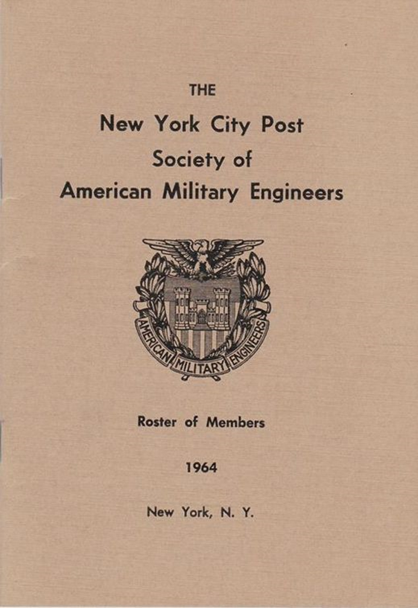
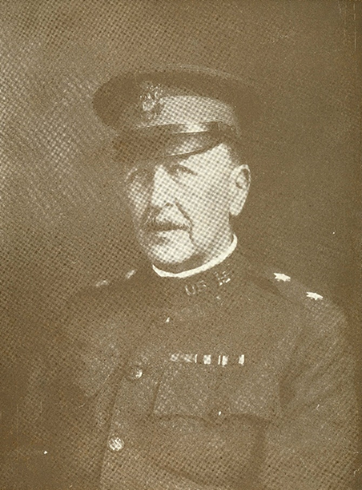
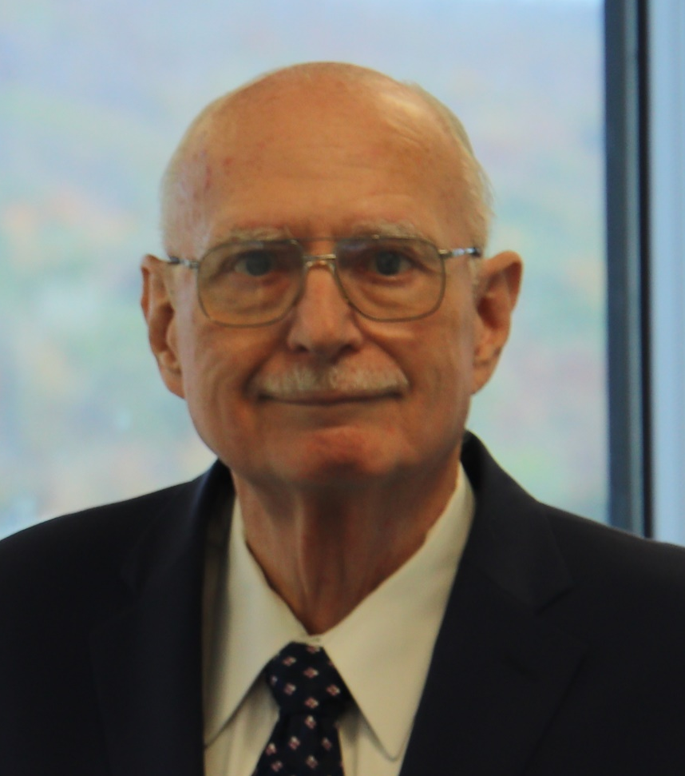
First National Leader of SAME
William Black
Narration by:
Mr. Joe Puzio
Notes:
National SAME and our NYC Post are both Celebrating a Century of Service
Starting in 1920

Slide 2

First National Leader of SAME
William Black
Narration by:
Mr. Joe Puzio
Notes:
National SAME and our NYC Post are both Celebrating a Century of Service
Starting in 1920

Slide 3

What’s your Legacy?
Both National SAME and the
New York City Post are 100 Years old with a Long and Strong History
OUR MISSION HAS ENDURED SINCE 1920
100
“We are … dedicated to patriotism and national security… To promote solidarity and co-operation between engineers in civil and military life, to disseminate technical knowledge bearing upon progress in the art of war and the application of engineering… To preserve and maintain the best standards and traditions of the profession…”. The Military Engineer magazine, January 1920
Narration by:
Mr. Joe Puzio
Notes:
Both National SAME and the New York City Post are 100 years old with a long and strong history
Our mission has endured since 1920 dedicated to patriotism and national security as stated in the Jan 1920 Military Engineer Magazine
To promote solidarity between engineers: civil and military to disseminate technology to support the art of war and engineering
To maintain the best standards of the profession

Slide 4
Celebration Overview: May 2019 – May 2021
  To generate awareness and excitement about SAME, with the aim of increasing member participation.
  To celebrate within the engineering profession with Stakeholders/Partners leading to collaboration and contribution.
SAME planning "Virtual JETC" starting May 27!
Narration by:
Mr. Joe Puzio
Notes:
Celebration goals are:
To generate awareness and excitement with aim to increase membership
To celebrate with engineering professionals, stakeholders and partner leading to collaboration and contribution.
SAME planning "Virtual JETC" starting May 27 to replace the Washington DC Event canceled due to COVID 19.

Slide 5
Photo Overview of NYC Post Century of Service
  Scholarship
  Members Leadership & Meetings
  Harbor Inspections
  North Atlantic Regional Conferences
  Cadet Construction Tours
West Point is an important part of our Post
with a 218 year history!
Narration by:
Mr. Joe Puzio
William Black: 1st Leader of SAME
Notes:
The NYC Post has provided a century of service with the West Point Cadets an important part of our Post.
In fact West Point has a 218 year history that we also celebrate.
The next few slides show a Photo Overview of the NYC Posts Strong History presented by major activities:
Scholarship
Members Leadership & Meetings
Harbor Inspections
North Atlantic Regional Conferences
Cadet Construction Tours

Slide 6
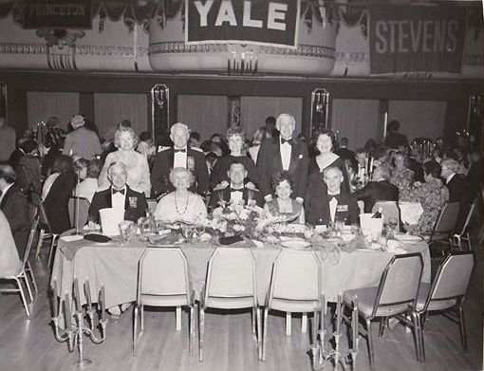
Scholarships
Dinner Dance Circa 1960

Slide 7
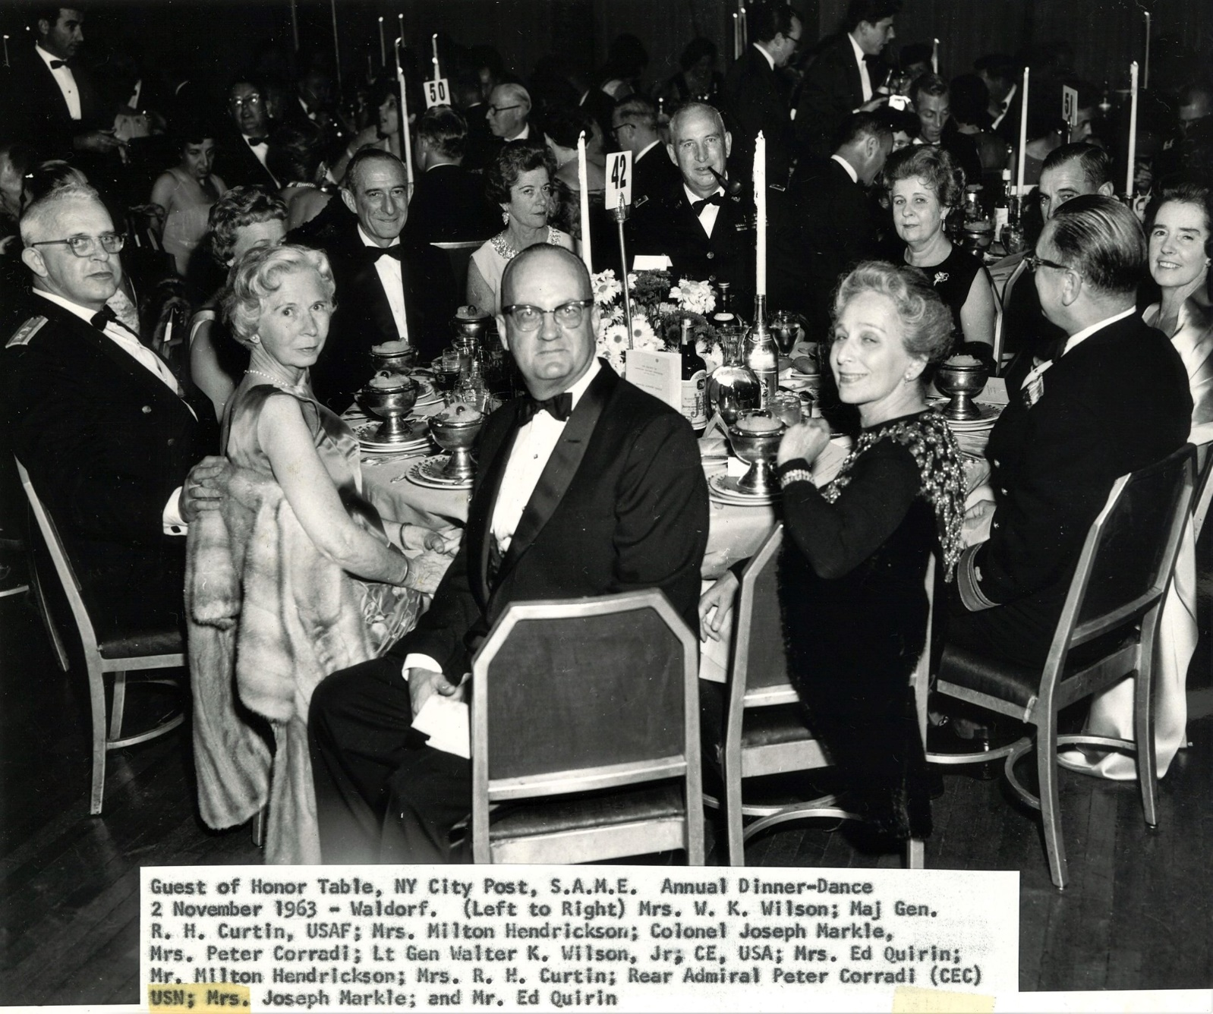
Scholarships

Slide 8
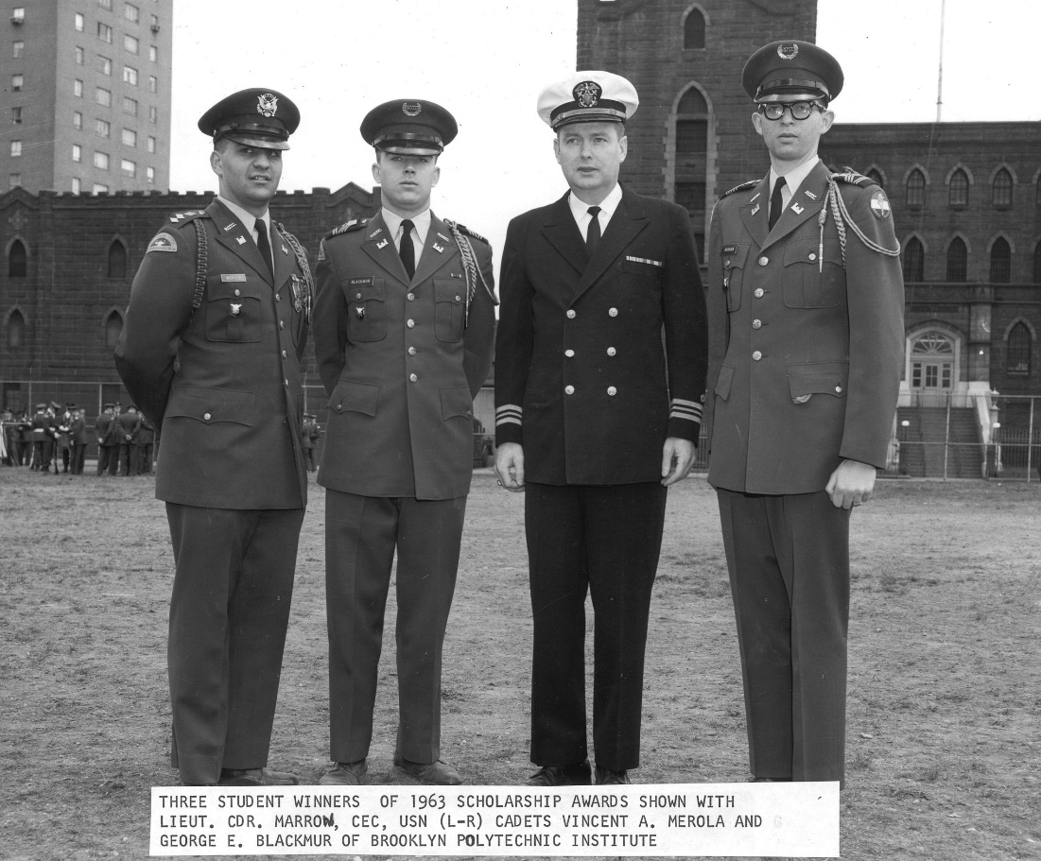
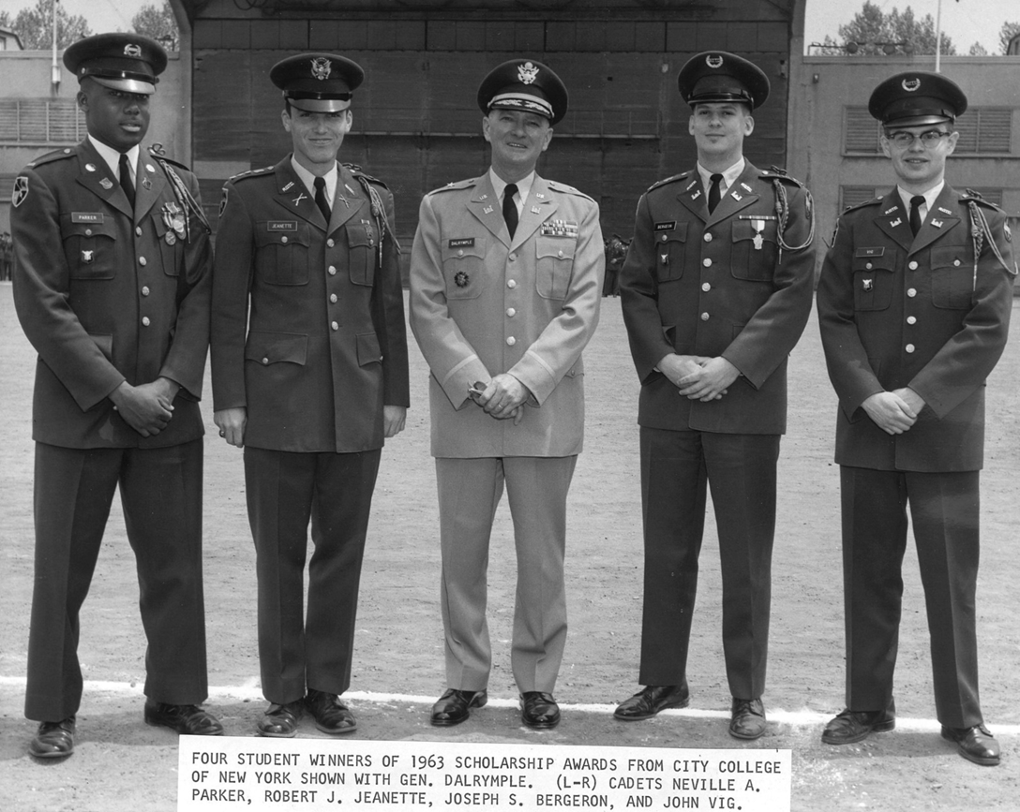
Scholarships

Slide 9
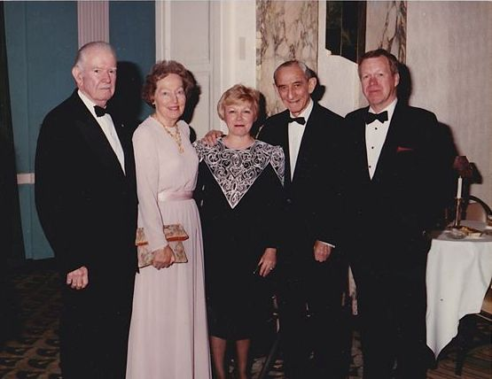
Scholarships
Col Joe Markle Surrounded By Nancy & Bud Griffis

Slide 10
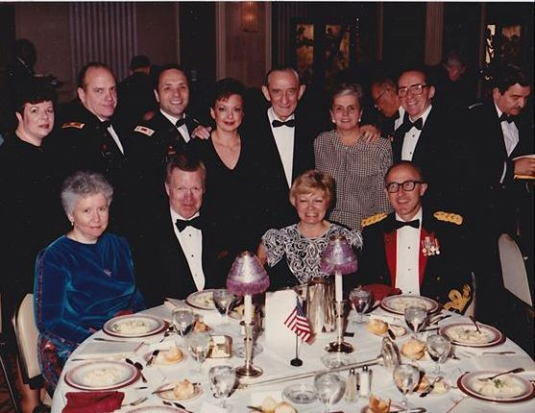
Scholarships
Circa 1986 – Dinner Dance

Slide 11
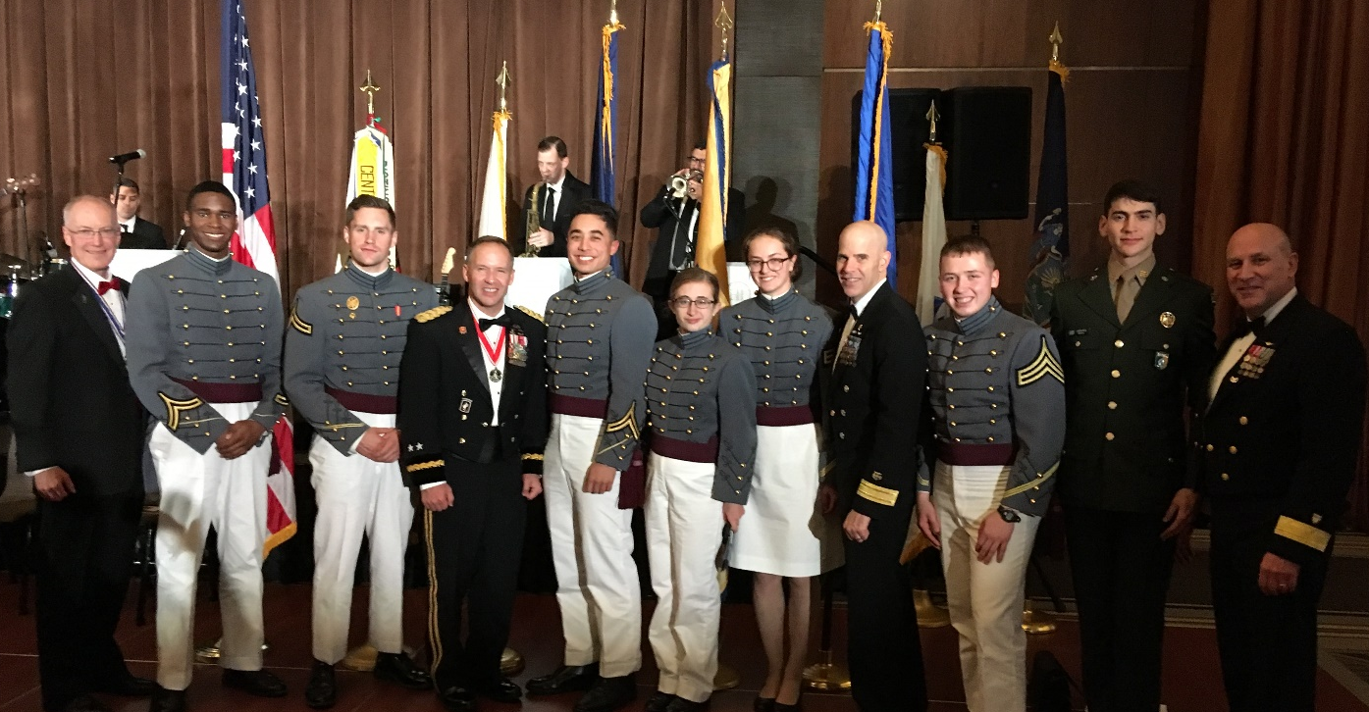
Scholarships
West Point Cadets at Scholarship Dinner Dance

Slide 12
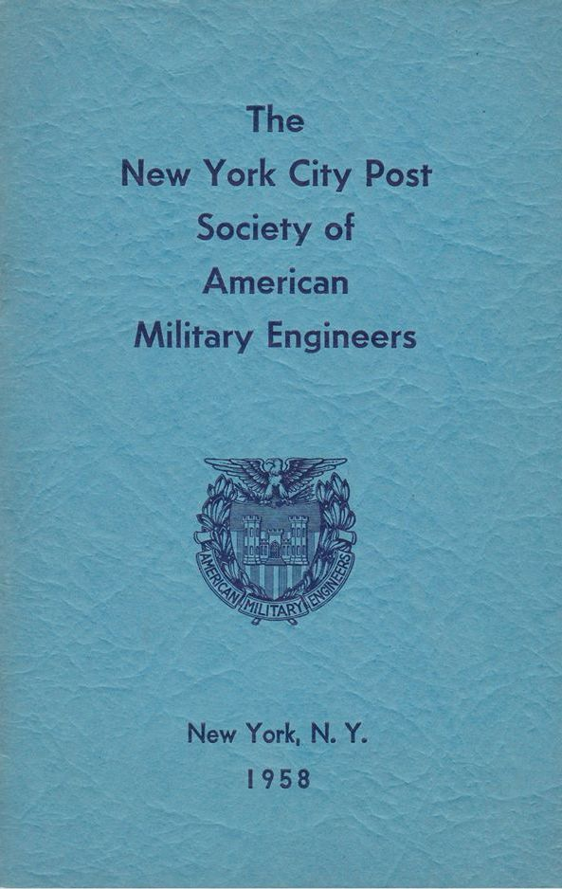
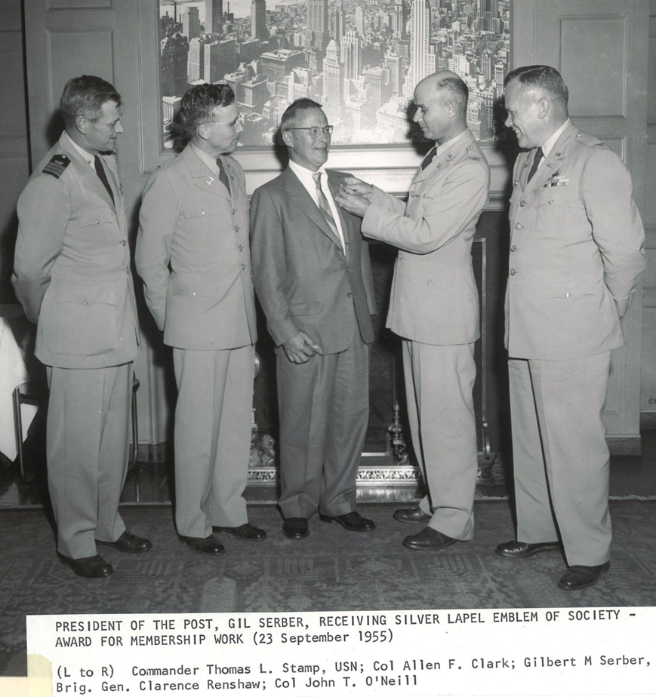
Members Leaders Meetings

Slide 13
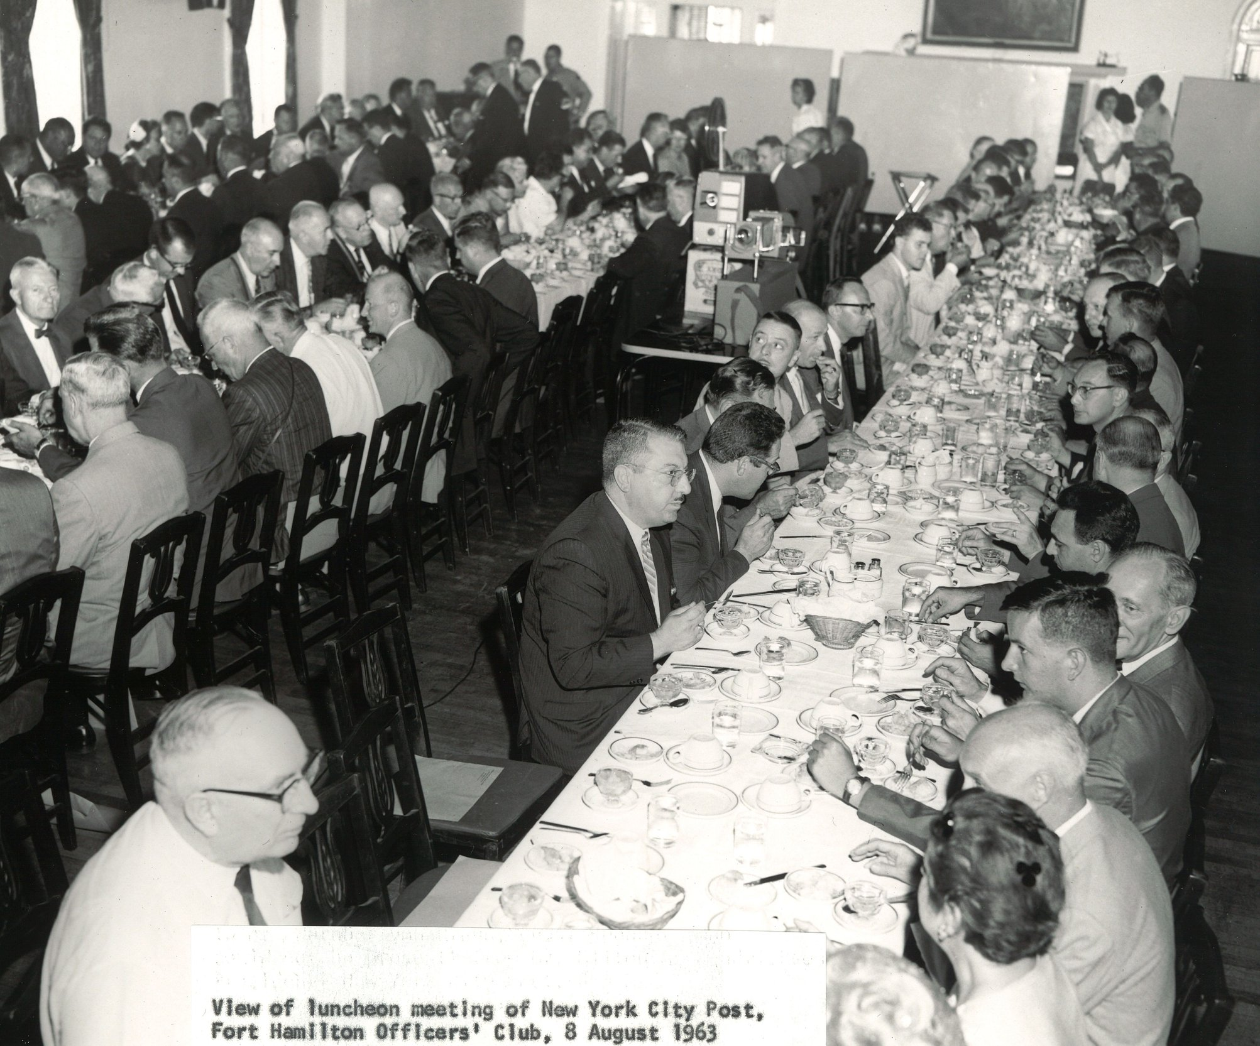
Members Leaders Meetings

Slide 14
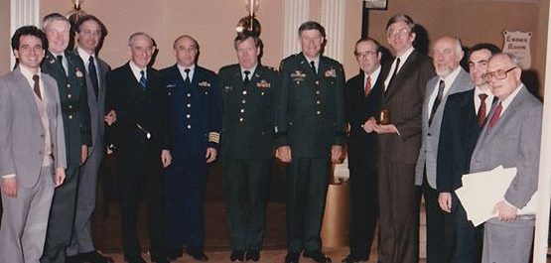
Members Leaders Meetings
Elected Officers – 1985

Slide 15
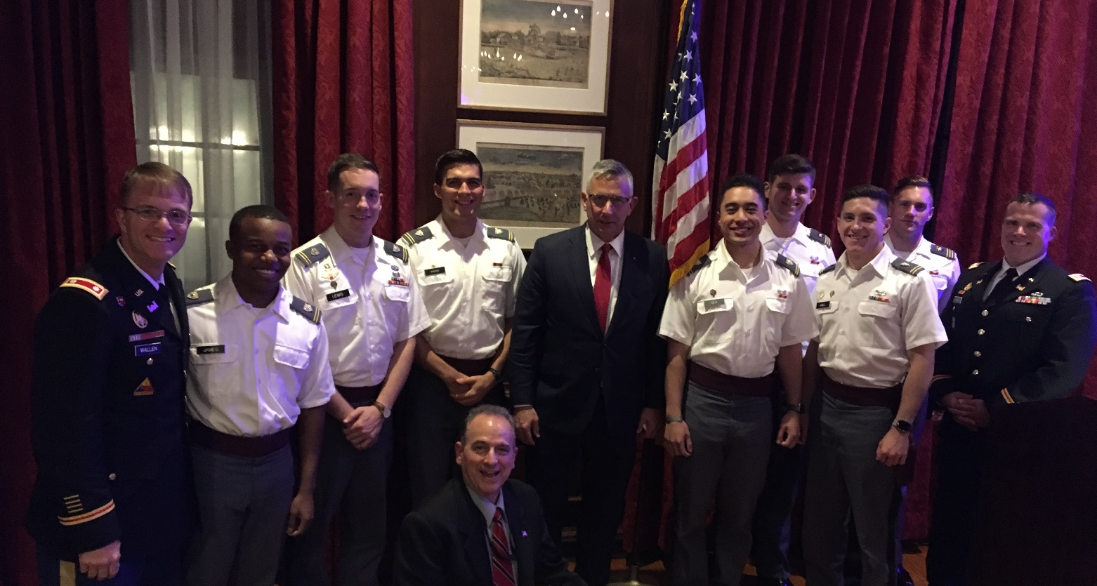
Members Leaders Meetings
Cadets at Post Evening Meeting

Slide 16
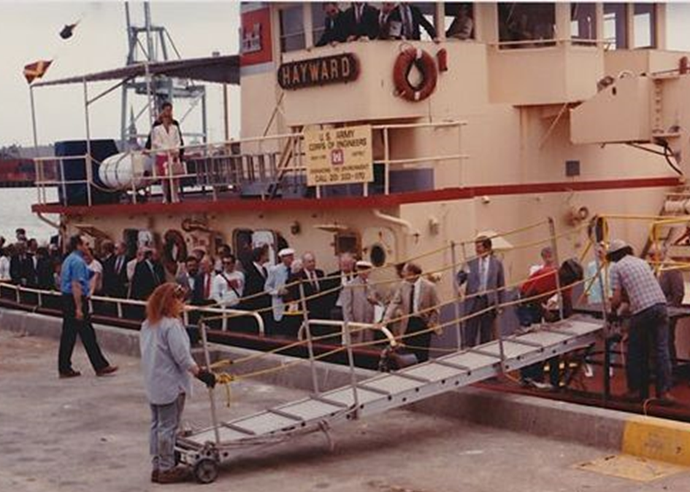
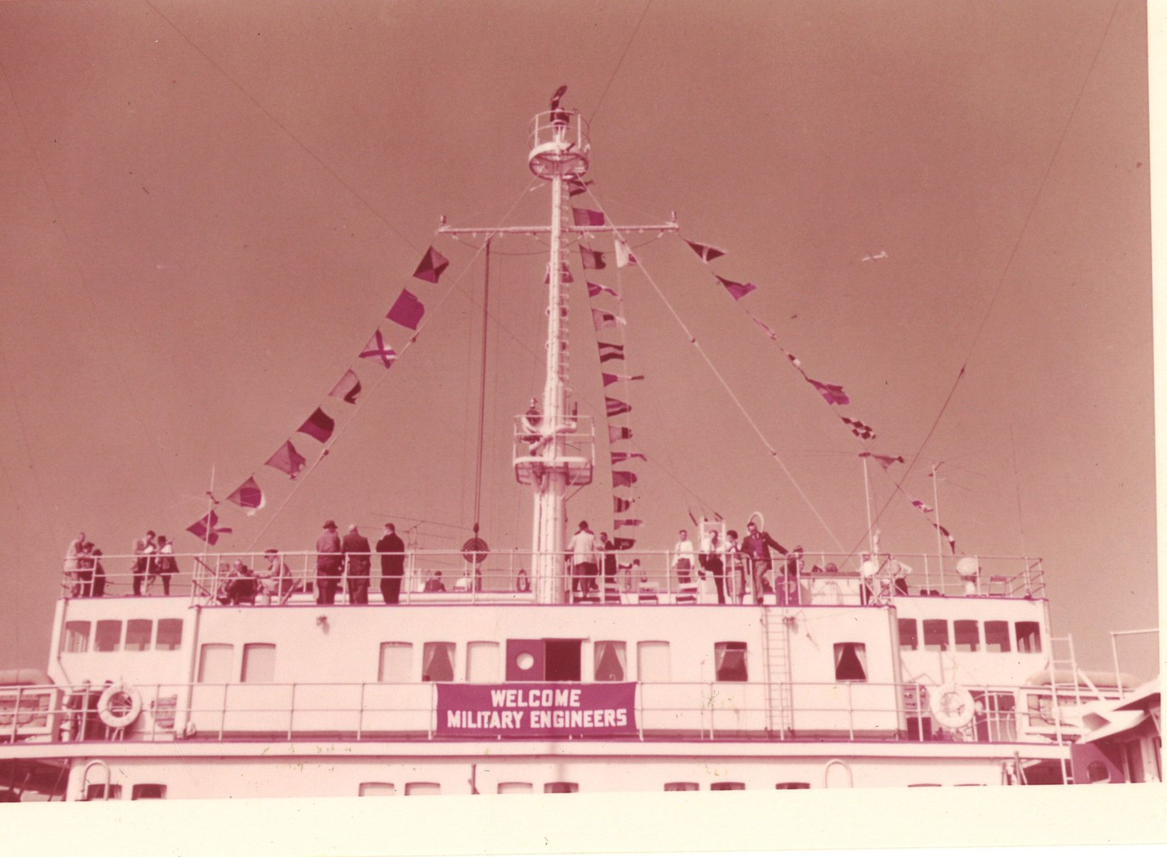
Harbor Inspections
One of Many Harbor Inspections
SAME Harbor Inspection 1963

Slide 17
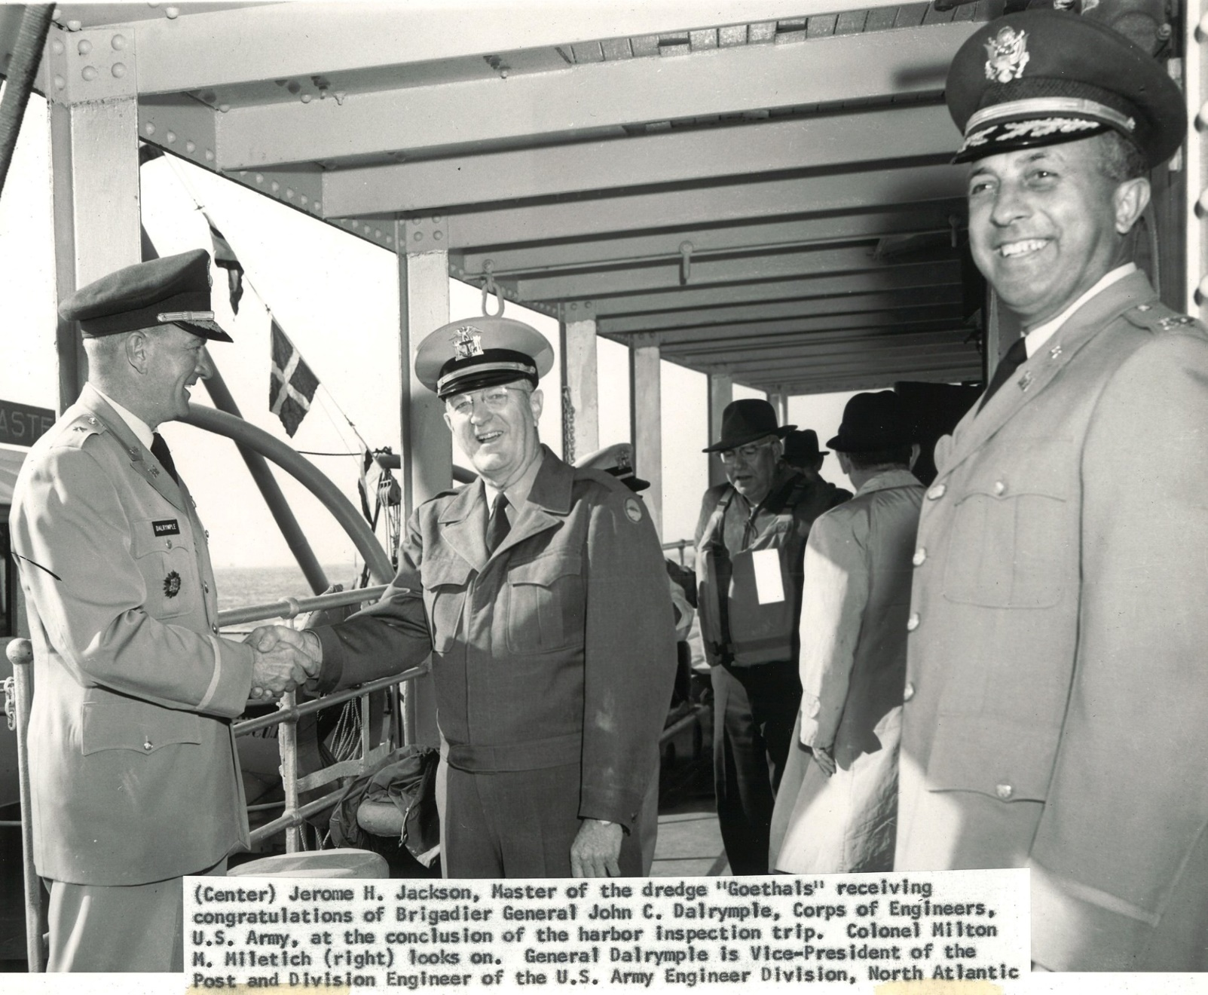
Harbor Inspections

Slide 18
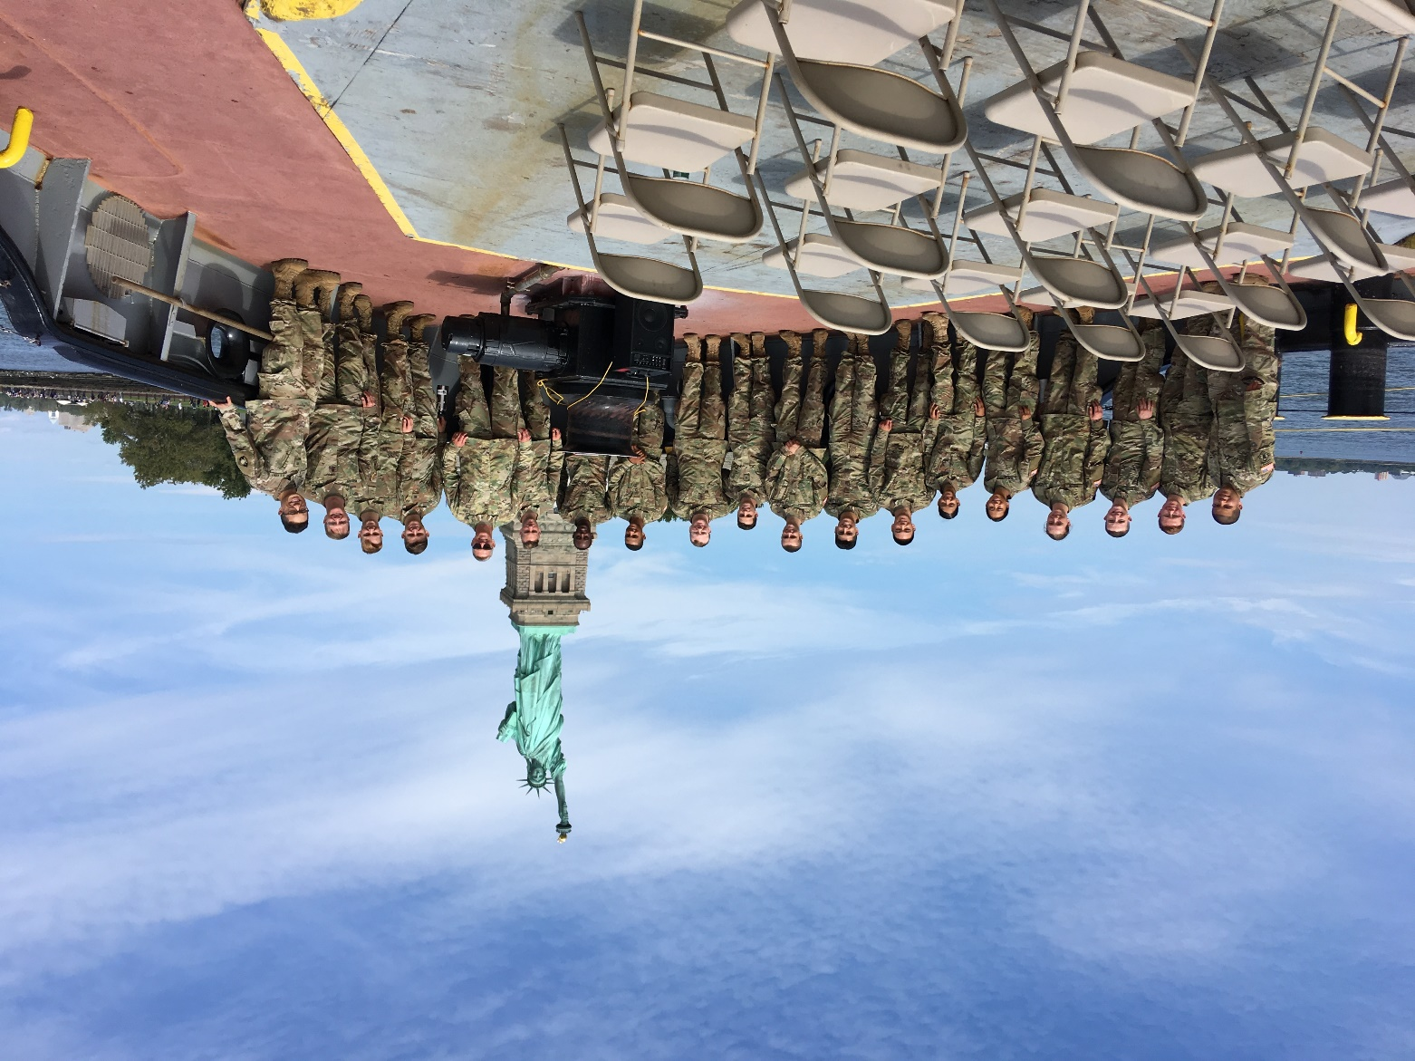
Harbor Inspections

Slide 19
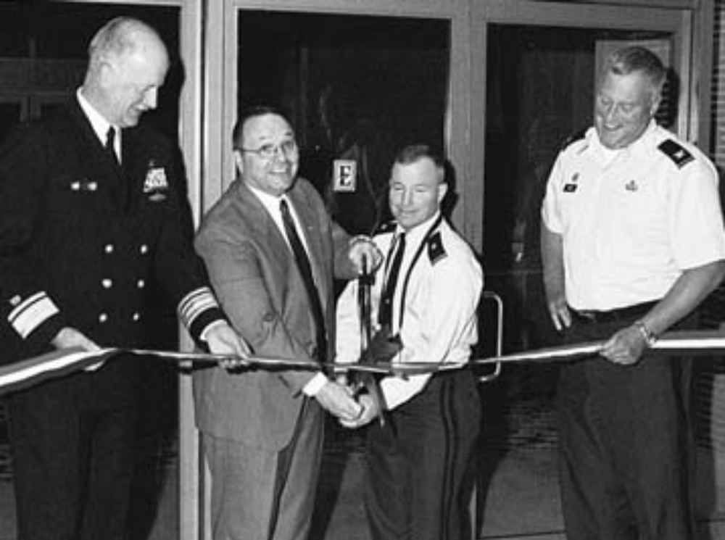
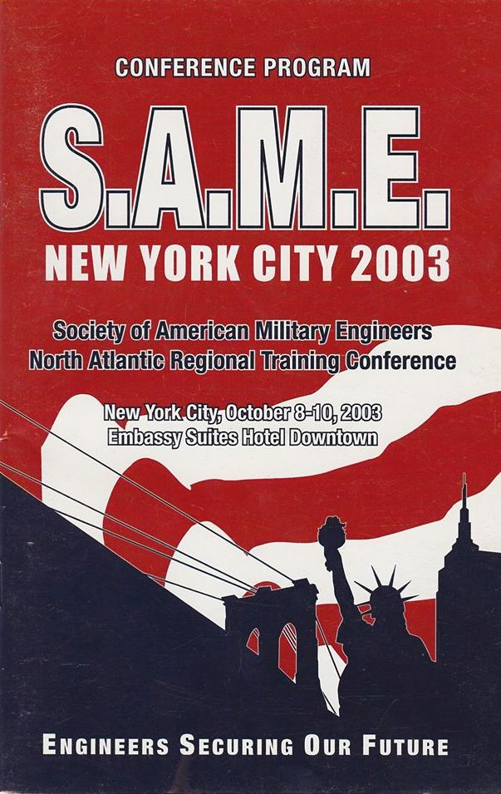
Regional Conferences
North Atlantic RVP, BG Bo Temple cuts ribbon to open the NARTC, along with Col John O’Dowd, Post President, RADM Michael Johnson, SAME President and BG(ret) Ralph Locurcio, Conference Co-Chair

Slide 20
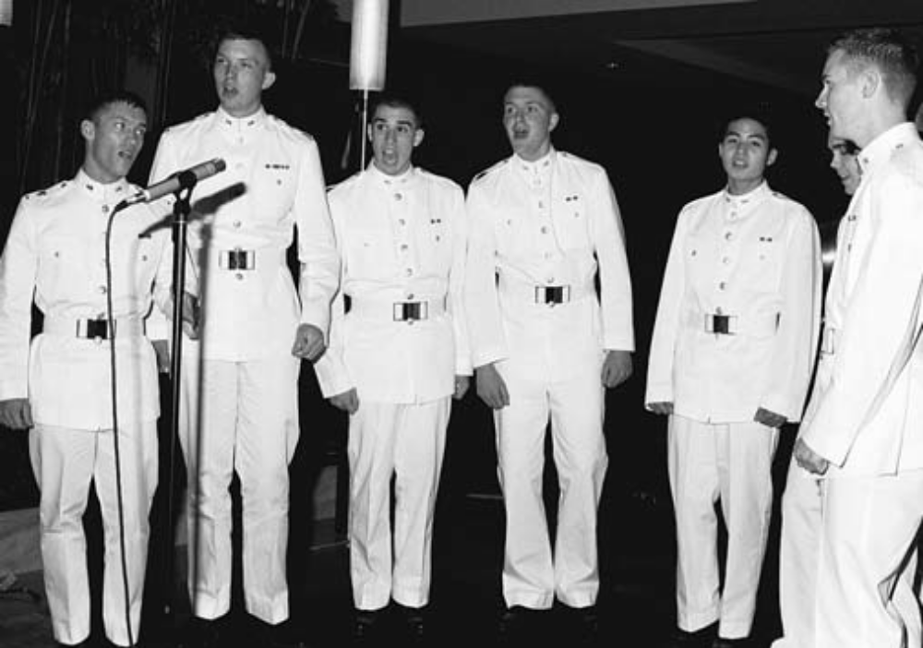
Regional Conferences
West Point Glee Club “Knight Caps” entertained banquet guests with a patriotic medley

Slide 21
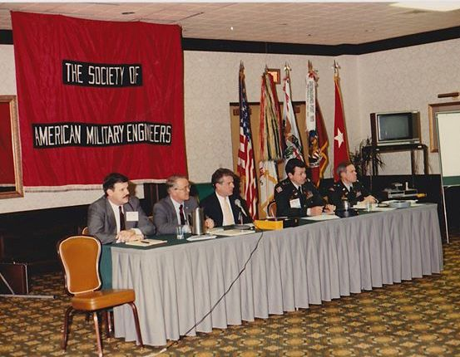
Regional Conferences
North Atlantic Regional Conference, West Point - NYC Post

Slide 22
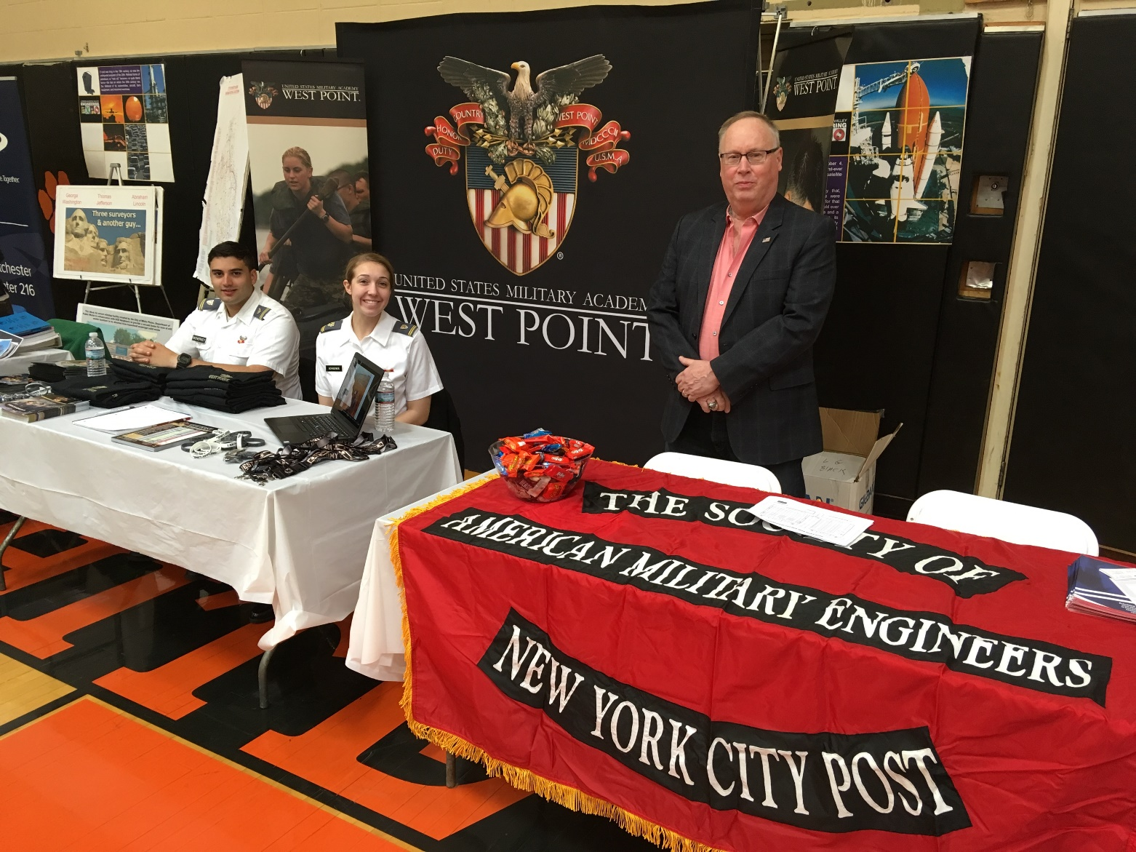
Regional Conferences
Hudson Valley Engineering Expo April 2018

Slide 23
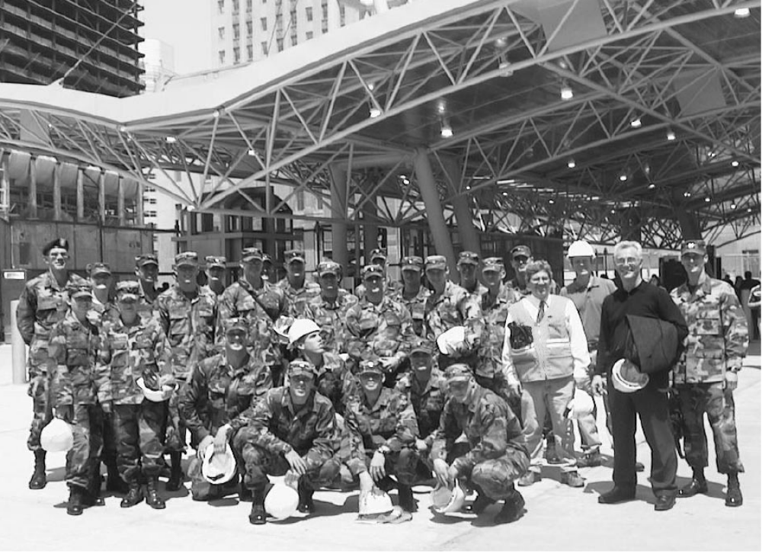
Cadet Construction Tours Ground Zero
2004 - Captain Matt Morris, West Point Depart. of Civil & Mechanical Engineering, with 24 cadets at Ground Zero

Slide 24
You can find more NYC Post Photos at
https://www.facebook.com/SAMENYCPOST
And additional information about the Post and SAME 2020 celebrations at
http://www.same-nyc.org
https://www.same.org/SAME-at-100

