Slide 1
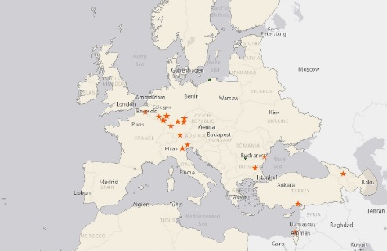
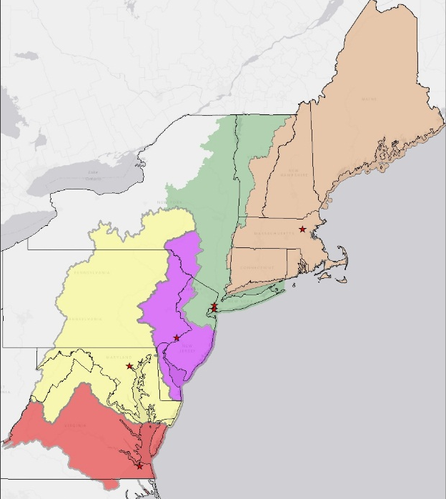
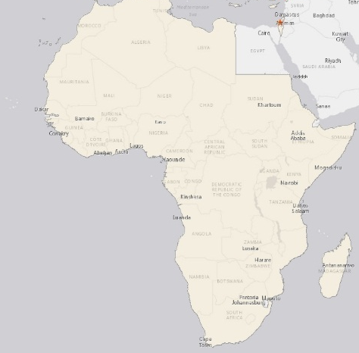
North Atlantic Division
Overview
1 of 9 USACE Divisions, consisting of six districts that plan, design, build, operate and maintain military and civil works projects and facilities within the region, Europe and Africa
Projects address the environmental, infrastructure, and water-resource challenges within the region
The Numbers
23% of U.S. population (72 M)
25.6% of U.S. coastal tonnage
3,300 employees
50 Army, 13 USAF installations
2685 mi. of navigation channels
650+ miles of levees/channels
8 major ports and Port Authorities
3 hurricane barriers and 8 high-level bridges
54 dams; 4 canals; 4 locks
Supports: 3 GCCs, 3 FEMA Regions, and 3 EPA Regions
Regionally aligned w/ Regional Fish & Wildlife Service
Division Capabilities
Master Planning, Sustainability
Construction Management
Engineering, Design, Inspection
Dredging, Operations and Maintenance
Disaster Response & Recovery
Environmental Services
Real Estate Services
Estimating, Value Engineering
Coastal Storm Risk Management
Modeling
Independent External Peer Review
Reach-back Capability
Support to Nation
EUCOM
Europe District
New England
New York
Philadelphia
Baltimore
AFRICOM
Norfolk
Vision: A World Class Engineering organization, renowned for its Professional Workforce and a Reputation staked on Program Delivery, and reliable Partnerships.
Notes:
As of August 10, 2015
Here are some of the important stats about our region. Key points to note is that we have a very high number of military installations in our footprint and that we have roughly a quarter of all members of congress representing districts in our region. Both of those facts have given us, historically and relatively, a very large program.

