Slide 1
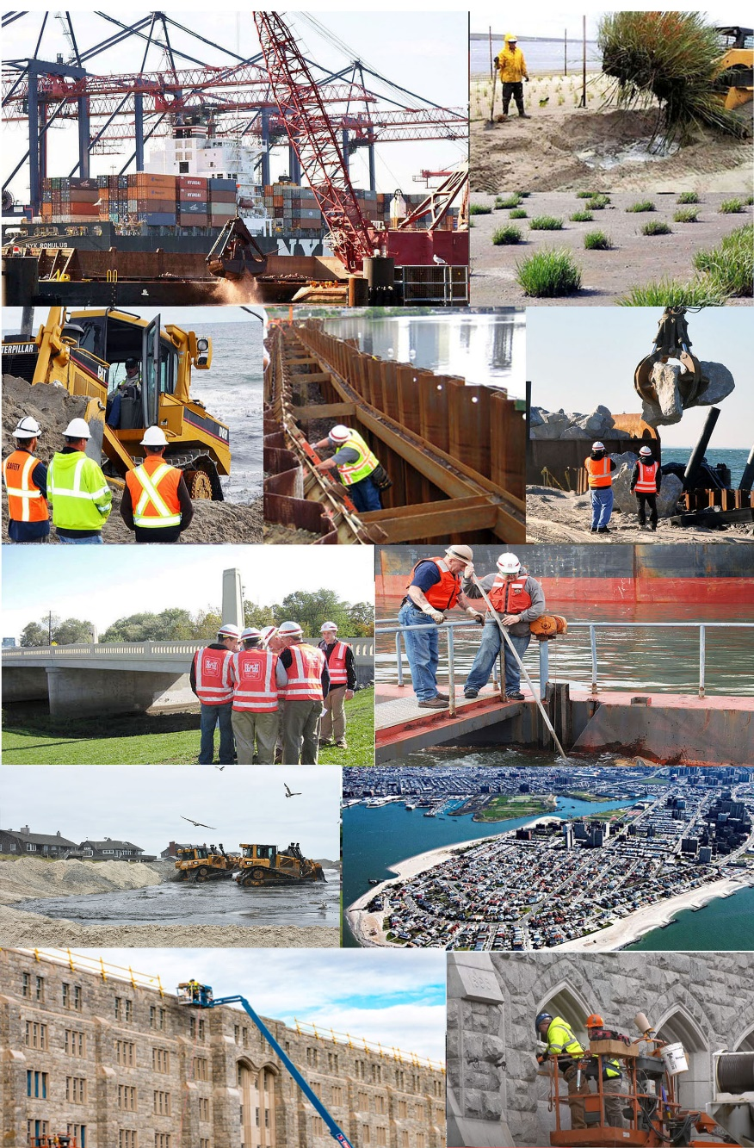
Briefing on the U.S. Army Corps of engineers New York District programs ENTERING FY21
NYC Post of the Society of American Military Engineers (SAME)
October 28, 2020
COL Matthew Luzzatto, P.E., P.M.P
Commander & District Engineer
BUILDING STRONG®

Slide 2
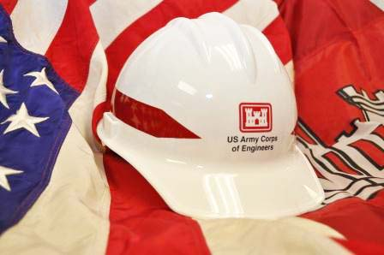
NEW YORK DISTRICT
Agenda
About the New York District
Major Ongoing & Future Initiatives
Where We Need Your Support

Slide 3
NEW YORK DISTRICT
About the New York District

Slide 4
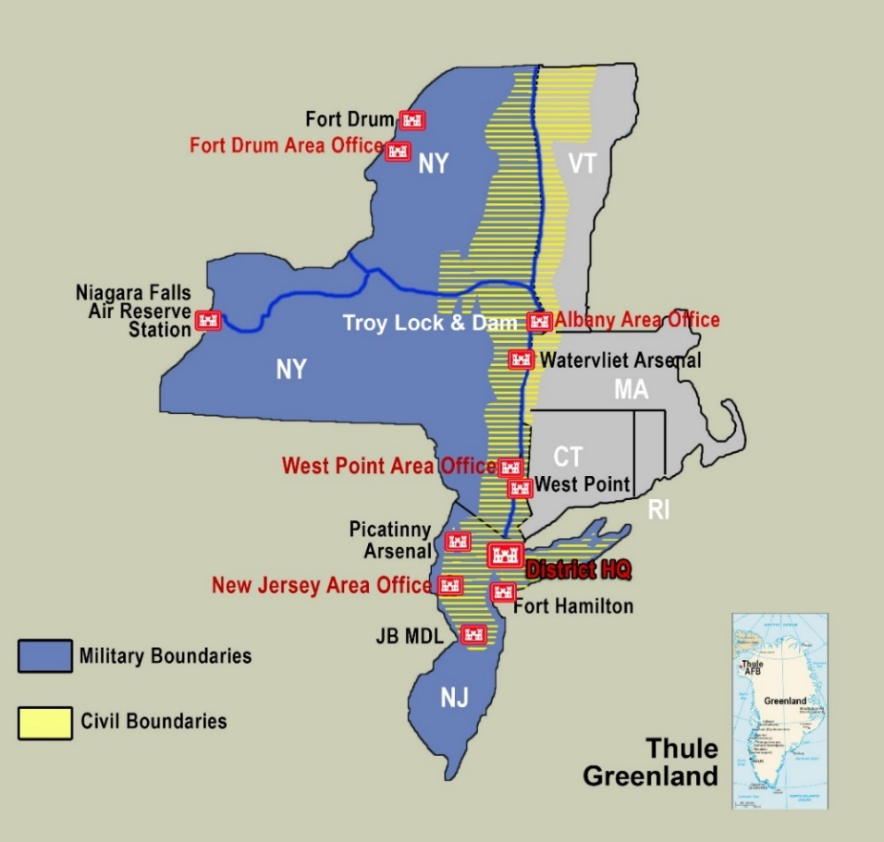
NEW YORK DISTRICT
MISSION
Deliver quality projects and services, respond to emergencies, and support contingency operations in order to reduce risk from natural disasters and to support the security of our Nation.
AREA OF RESPONSIBILITY
Personnel: 550 civilians/5 military
26,500 square miles
400 miles of coastline under study/construction
Port of New York & New Jersey
550 miles of navigation channels (240 miles within Port of NY/NJ)
6 major river basins: Passaic, Hackensack, Raritan, Bronx, Hutchinson, Hudson
Lake Champlain Basin
8 Military Installations: West Point, Fort Drum, Fort Hamilton, Watervliet Arsenal, Niagara Falls ARS, Picatinny Arsenal, Joint Base McGuire-Dix-Lakehurst (JBMDL), Thule AB Greenland
Environmental: FUSRAP, FUDS, SUPERFUND, BRAC
Support 559 recruiting stations
Regulatory Program – New York, New Jersey
Significant High Risk Emergency Response Areas
Serving 20 million people in 37 Congressional districts
Notes:
8 Major River Basins include: Hudson, Mohawk, Passaic, Hackensack, Raritan, Saw Mill, Ramapo & Hutchinson
MILCON installations include:
1- West Point
2- Ft. Drum
3- Picatinny Arsenal
4- McGuire AFB
5- Ft. Hamilton
6- Thule AFB
7- Niagara Falls Air Reserve Station
8- Military Entrance Processing Command (MEPS)
9- Ft. Monmouth
10-Watervliet Arsenal

Slide 5
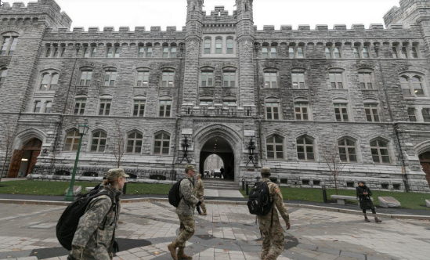
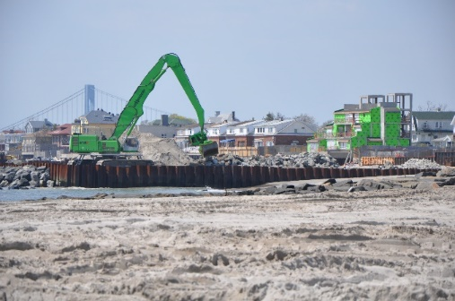
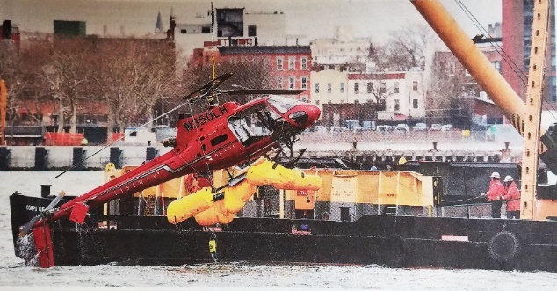
WHAT WE DO
Plan, design, construct, operate
and maintain civil works facilities and infrastructure
Plan, design, construct and support
facilities and infrastructure for military
and other customers
Execute the regulatory program
Respond to emergencies and contingency operations
Provide management, administrative and logistical support for district programs and projects
Conduct environmental remediation
and restoration

Slide 6
NEW YORK DISTRICT
Operating During a Pandemic
The District never closed or stopped executing…
New York District has an honored heritage, passionate workforce and reliable reputation…
With ~65% of the workforce on telework, the District has continued to operate at a high level and DELIVERING a diverse program for more than 100 stakeholders and partners
The District WELCOMED its 54th Commander/ District Engineer on June 25th at a virtual Change of Command ceremony
DELIVERED on commitments and successfully Executed major contract actions and construction, including construction of Alternate Care Facilities, in the period where NY/NJ were the epicenter of the COVID-19 pandemic, civil unrest and protests...and PREPARED for the active 2020 Atlantic hurricane season
USA TODAY RECOGNIZED the Corps of Engineers in a June Edition highlighting COVID19 response and work at USMA
FY20 Contracting has awarded 683 actions for a total of ~$720M; >50 actions are $1M or over; 391 actions were Small Business with a total of ~$92M

Slide 7
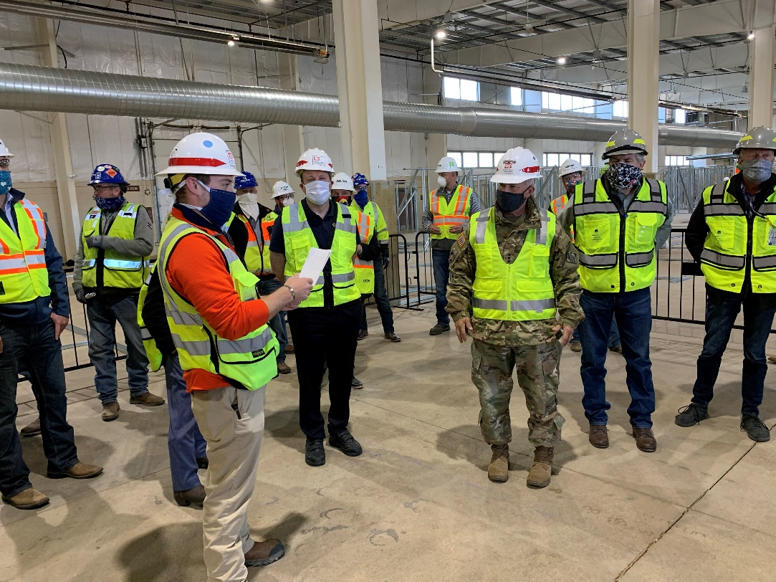
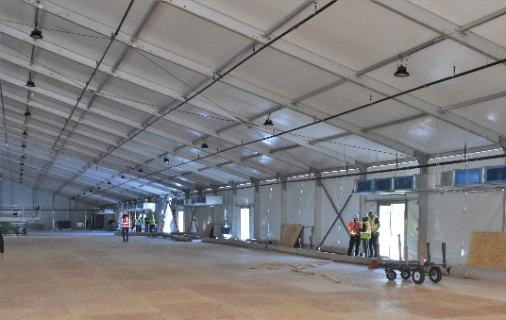
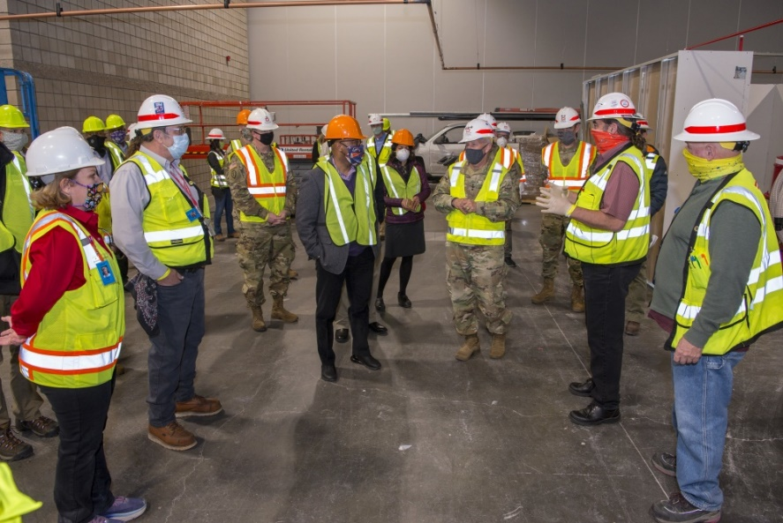
NEW YORK DISTRICT
Operations During COVID-19 Pandemic
People First! Mission Always!
Personnel Protective Equipment

Slide 8
NEW YORK DISTRICT
Program Outlook FY21 & FY22

Slide 9
New York District
Program Amounts
(in expenditures)
(in expenditures)
 | FY 21 | FY 22
Military Program | $242M | $387M
Civil Works Program | $385M | $563M
Environmental Interagency & International Support (EIIS) | $121M | $160M
Total Program | $869M | $989M

Slide 10
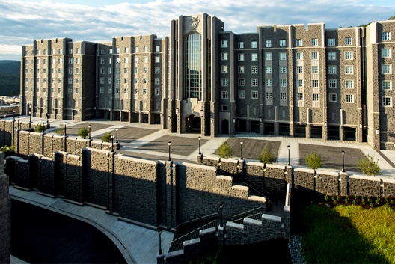
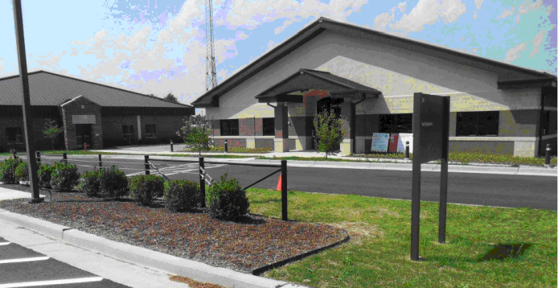
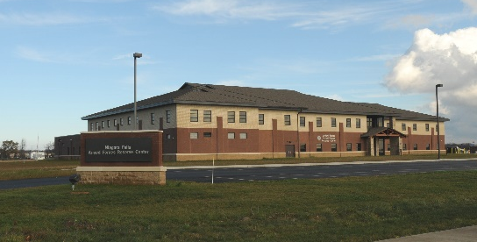
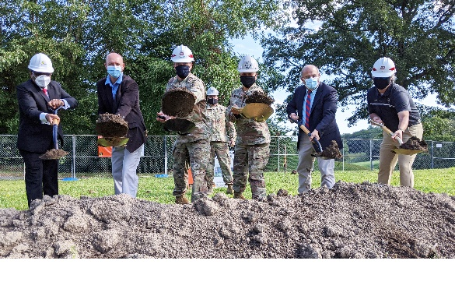
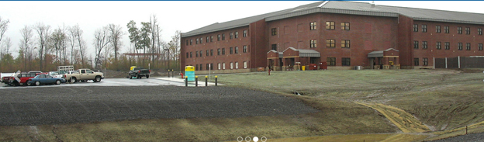
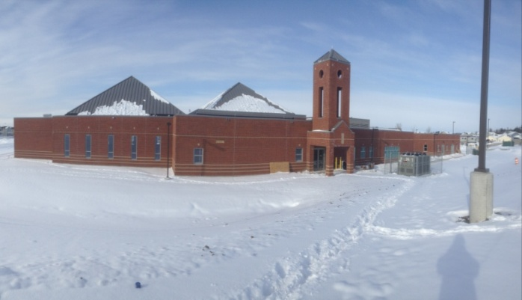
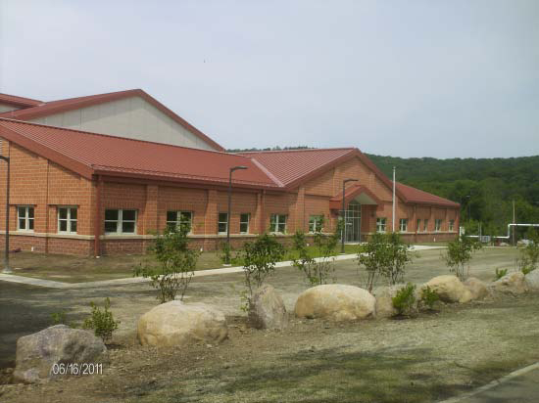
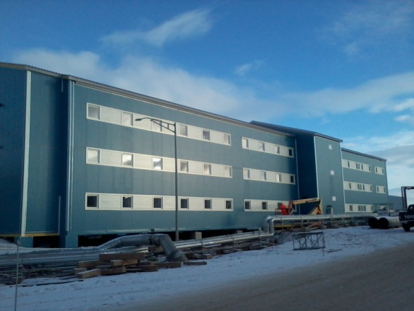
Military Programs
Military Construction Support
  U.S. Military Academy, West Point, N.Y.
  Fort Drum, N.Y.
  Fort Hamilton, N.Y.
  Watervliet Arsenal, N.Y.
  Niagara Air Force Base, N.Y.
  Picatinny Arsenal, N.J.
  Joint Base McGuire-Dix-Lakehurst, N.J.
  Thule Air Base, Greenland
U.S. Military Academy West Point, New York
Davis Barracks
Joint Base McGuire-Dix-Lakehurst Base New Jersey
Fort Drum, New York Troop Barracks
Niagara Falls Armed Forces Reserve Center, New York
Groundbreaking Golf Course Club House,
U.S. Military Academy West Point
Picatinny Arsenal, New Jersey
Packaging, Handling, Shipping and Transportation Facility
Thule Air Base, Greenland
Fort Drum, New York
Child Development Center
Notes:
10

Slide 11
FY21
Military Construction
Location | Project | Scope | Project Cost Range | Targeted Acquisition | Projected RFP Date
West Point, NY | Lee & Sherman Barracks Renovation | Renovate Existing Barracks | $25-100M | UR DBB | Q4 FY21
Watervliet Arsenal, NY | Chrome Plating Facility | Renovate Chrome Plating Facility | $25-100M | UR DBB | Q2 FY21
West Point, NY | Patton Complex | Construct General Instruction Bldg. | $5-10M | SB DBB | Q4 FY21
West Point, NY | Cullum Hall Renovation | Renovate Existing Historic Structure | $25-100M | SB/UR DBB | Q3 FY21
Watervliet Arsenal, NY | Heat Treat Gun Tube Furnace | Construct & Install new Heat Treat Gun Tube Furnace | $25-100M | UR DB | Q2 FY21
West Point, NY | West Point Club | Renovate Existing Structure | $5-10M | SB DBB | Q3 FY21
West Point, NY | Camp Revitalization | Renovate Multiple Barracks Phase I | $10-25M | SB Adapt-Build | Q1 FY21
JB MDL, NJ | Commercial Vehicle ECP | Construct a new entry control point | $5-10M | SB DBB | Q2 FY21
JB MDL, NJ | Munitions Storage | Construction new Munitions Storage faicluty | $10-25M | UR DBB | Q3 FY21

Slide 12
FY21
Military Construction
Location | Project | Scope | Project Cost Range | Targeted Acquisition | Projected RFP Date
Floyd Bennett Field, NY | POV Parking | Construct new parking and entry control. | $1 - 5M | SB DBB | Q1 FY21
Floyd Bennett Field, NY | Fire Protection System | Construct Fire Protection System | $1 - 5M | SB DBB | Q1 FY21

Slide 13
FY 22
Military Construction
Location | Project | Scope | Proj. $ | Targeted Acquisition | Projected RFP Date
West Point, NY | Bldg. 624 Renovation | Renovate Existing Barracks | $25-100M | SB/UR DBB | Q1 FY22
West Point, NY | Delafield Dam | Decommission the Dam | $5-10M | SB DBB | Q2 FY22
West Point, NY | MEDDAC / DENTAC | Renovate Bldg. 785 for MEDDAC / DENTAC | $10-25M | SB DBB | Q4 FY22
West Point, NY | Camp Revitalization | Renovate Multiple Barracks Phase II | $10-25M | SB Adapt-Build | Q1 FY22
Watervliet Arsenal, NY | Gillespie Gate | Construct New Access Control Point | $10-25M | SB DBB | Q2 FY22
Watervliet Arsenal, NY | Bldg. 20 Renovation | Renovate Existing Manufacturing Bldg. | $5-10M | SB DBB | Q3 FY22
Fort Drum, NY | Shielded Power | Construct HEMP Shielding | $5 - $10M | SB DBB | Q2 FY22

Slide 14
FY21
Military A/E
Location | Project | Scope | Project $ | Targeted Acquisition | Projected. RFP Date
NAN/NAD Boundaries | MATOC General AE Services to primarily Support Thule AB And other installations In the NAN/NAD Region | Planning and Design Services | $200M shared capacity over 5 years; 5 firms | TBD | Q1 FY21
NAN/NAD Boundaries | MATOC General AE Services to primarily Support the ABUP at USMA as well as other installations in the NAD/NAD Region | Planning and Design Services | $50M shared capacity over 5 years; 3 firms | TBD | Q1 FY22

Slide 15
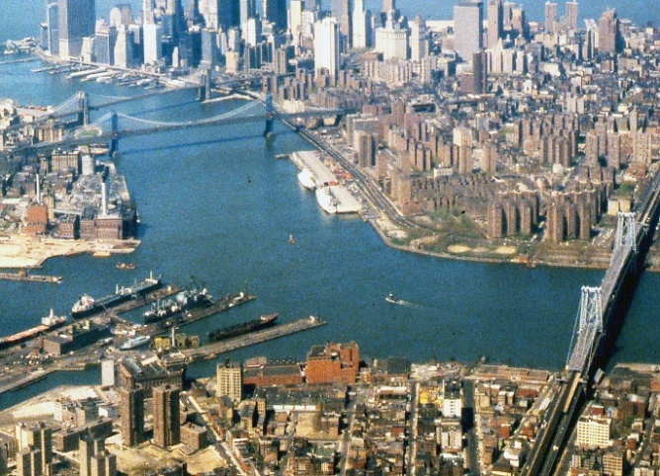
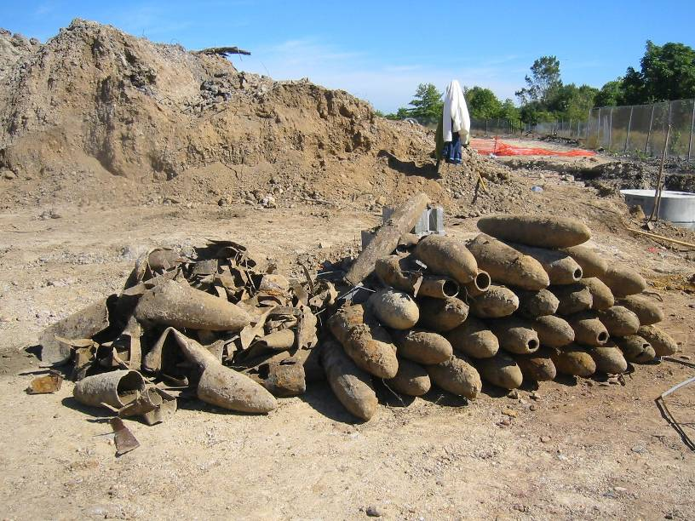
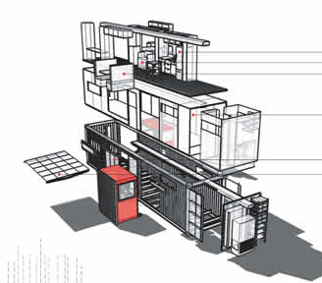
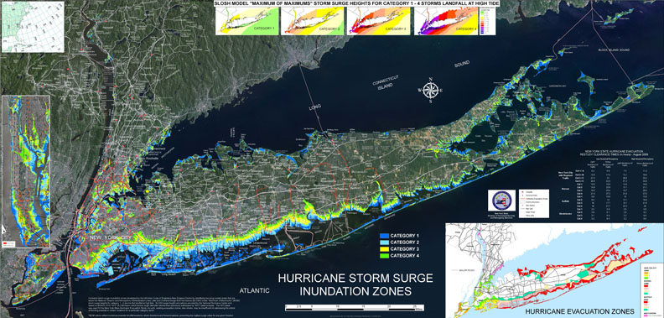
Interagency, International & Environmental
Services
NYC DOT - East River Bridges
Formerly Used Defense Sites (FUDS)
Hazard mitigation work - Security Upgrades
Former Raritan Arsenal - Edison, NJ
NYC OEM – Hurricane Planning and Preparedness Studies
Hurricane Storm Surge Mapping Analysis for New York State and New York City
Notes:
USACE has performed work for New York City Office of Emergency Management on hurricane evacuation and preparedness studies. The work has included storm surge mapping the vulnerable areas of New York State and detailed analysis for New York City, disaster impact modeling, and emergency power exercises. In addition, USACE has issued a contract to construct a prototype for urban interim housing to evaluate the use of stackable modules to achieve a higher density post-disaster solution. The work has been very beneficial to NYC and played a role in how NYC prepared for and responded to Hurricane Sandy.
(Slide shows areas in New York State and NYC that can be impacted by hurricane storm surge). FY14 Budget = $12.3M. Ongoing work will continue using prior year funding.
Some additional examples of partnerships through IIS:
Port Authority of New York & New Jersey – Wetland Creation
New Jersey Department of Environmental Protection – Liberty State Park Design
Homeland Security – Plum Island New Bulkhead and Dredging
National Oceanic and Atmospheric Administration – Wetland Creation
National Park Service – Beach Nourishment, Ferry Traffic Study
Veterans Affairs – Hospital Upgrades
General Services Administration – African American Burial Ground

Slide 16
FY21
EIIS Construction
Location | Project | Scope | Proj. $ | Targeted Acquisition | Projected RFP Date
NY | Dept. of VA | Parking Garage | $5M-$10M | SDVOSB | TBD
NY | NCA | Demo Bldg 165 & 166 And Master Plan Columbarium | $5M-$10M | SDVOSB | Q2 FY 21

Slide 17
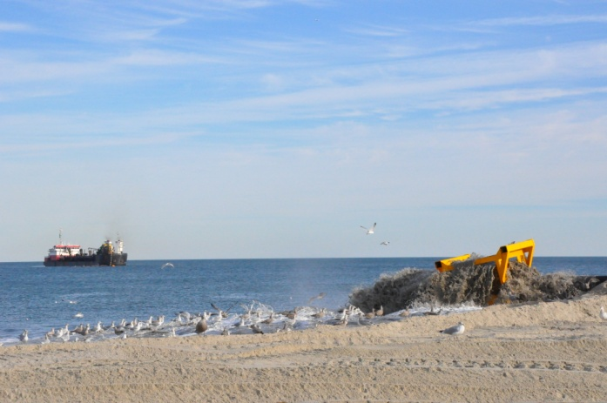
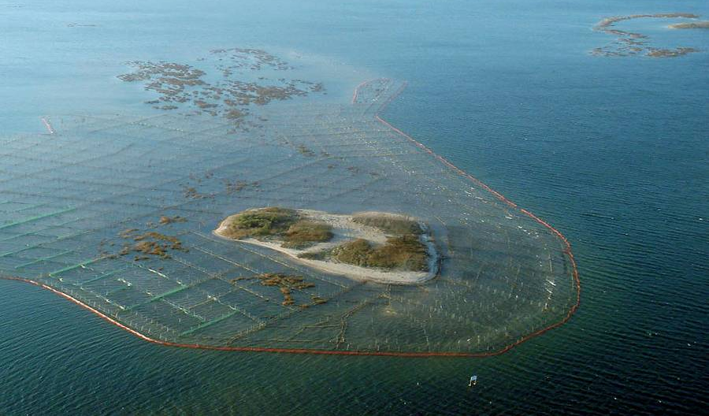
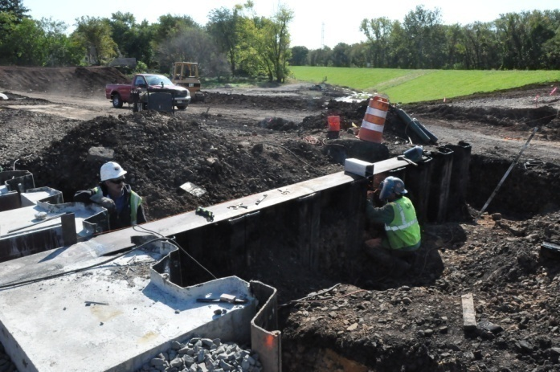
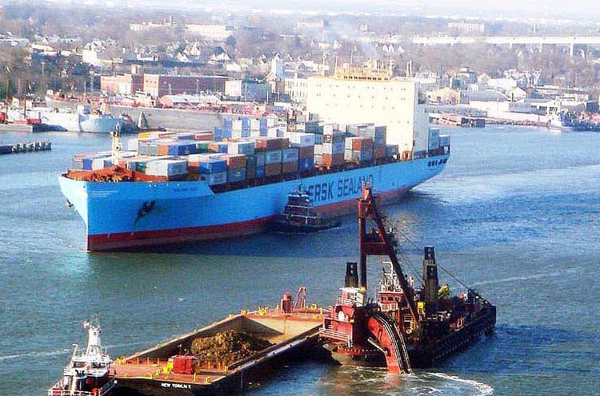
Civil Works
Coastal Storm Damage Reduction
Environmental Restoration
Coastal Restoration, Monmouth Beach, NJ
Marsh Islands Restoration, Jamaica Bay, NY
Flood Risk Management
Navigation
Green Brook NJ flood damage reduction system
Dredging in the Port of NY and NJ
Notes:
NAN CW program is made up into 3 primary lines:
Flood Risk Management (including coastal and riverine flood risk reduction): NAN is a coastal district with over 400 miles of coastline with nearby densely populated and heavily developed communities at risk to coastal flooding caused by storm surge and wave impacts. NAN has several river basins (i.e. Passaic) with densely populated and heavily developed floodplains that are at high risk to flood damages.
Environmental Restoration: The New York metropolitan region is one of the most densely populated areas in the nation and has been subject to nearly 400 years of development and urbanization, the industrial revolution, and associated environmental degradation that presents a series of significant water resources challenges due to water quality impacts, loss of wetlands, and decline of aquatic habitat.
Navigation: The Federal navigation channels are an important component of the region’s economy and transportation system in terms of commerce, jobs, and recreation. NAN has 550 miles of navigation channels, 240 of which are within the deep draft Port of NY and NJ, which is the largest container port on the East Coast and third largest in the U.S.

Slide 18
FY20/21
Civil Works Construction
Location | Project | Scope | Projected $ | Targeted Acquisition | Projected RFP Date
NJ | Green Brook Seg C2 & H Contract | Levee/Floodwall / Road Closure Gates | $50M, $10M Base plus $40M Options | IFB | Q3 FY21
NJ | Green Brook – Piscataway Non-Structural Measures | Non-Structural Measures | $1M - $3M | IFB-SB | Q3 FY21

Slide 19
FY 21
Construction
(Sandy Program)
Location | Project | Scope | Projected $ | Targeted Acquisition | Projected RFP Date
Newark, NJ | Joseph Minish, NJ Contract 3B/4B | Bulkhead | $10-25M | IFP | Q1 FY21
Middletown NJ | Port Monmouth NJ Contract 5 | Levee/floodwall, Pump Station, Road Raising | $10-25M | IFB | Q1 FY21
Queens, NY | Rockaway Contract 2 | Beachfill, Reinforced Dune | $25-100M | IFB | Q3 FY 21
Queens, NY | Rockaway Contract 3 | Permanent Access Features (Dune Crossovers) | $5-10M | Small Business IFB | Q4 FY 21
Newark, NJ | Passaic River Tidal Contract 1 | Floodwall | $10-25M | IFB | Q4 FY 21

Slide 20
FY21
Civil Works A/E
Location | Project | Scope | Projected $ | Targeted Acquisition | Projected RFP Date
NAN/NAD Boundaries | MATOC General AE Services for Primarily Riverine Flood Risk Mgmt. and Ecosystem Restoration Projects to Include Green Brook FRM Project in the NAN/NAD Region | Planning and Design | $80M shared capacity over 5 years; 5 firms | 3 Full and Open; and 2 SB | Q1 FY21
NAN/NAD Boundaries | MATOC General AE Services for Primarily Navigation, Coastal Flood Risk Mgmt. and Ecosystem Projects in the NAN/NAD Region | Planning and Design | $50M shared capacity over 5 years; 3 firms | Full and Open | Q1 FY21

Slide 21
FY21
Civil Works Dredging
Location | Project | Scope | Projected $ | Targeted Acquisition | Projected RFP Date
New York | Jamaica Bay | Maintenance dredging with ocean placement | > $5M | F&O/IFB | Q2 FY21
New York | Hudson River-Albany Turning Basin | Maintenance dredging with upland USACE-owned Houghtailing Island placement | $1-5M | F&O/IFB | New York
New Jersey | Newark Bay (40ft Reach) | Maintenance dredging with processing/upland placement | > $10M | F&O/IFB | Q3 FY21
NY&NJ | NY&NJ Channels-Arthur Kill | Maintenance dredging with processing/upland placement | > $10M | F&O/IFB | Q3 FY21
New Jersey | NY Harbor-Sandy Hook Channel | Maintenance dredging with ocean placement | $1-5M | F&O/IFB | New Jersey

Slide 22
FY22
Civil Works Dredging
Location | Project | Scope | Projected $ | Targeted Acquisition | Projected RFP Date
New York | Buttermilk Channel | Maintenance dredging with ocean placement | $>5M | F&O/IFB | Q3 FY22
New York & New Jersey | NY & NJ Harbor-Newark Bay (50ft Reach) | Maintenance dredging with processing/upland placement | > $10M | F&O/IFB | Q3 FY22
New Jersey | Newark Bay (40ft Reach) | Maintenance dredging with processing/upland | >$10M | F&O/IFB | New Jersey
New York | Hudson River | Maintenance dredging with upland USACE-owned Houghtailing Island placement | >$5M | F&O/IFB | Q3 FY22
New York & New Jersey | NY & NJ Harbor-KVK | Maintenance dredging with processing/upland placement or ocean placement | > $10M | F&O/IFB | Q3 FY22
New York | East Rockaway Inlet | Maintenance dredging with beach placement | > $10M | F&O/IFB | Q4 FY22
NY Harbor-Sandy Hook Channel | Maintenance dredging with ocean placement | $1-5M | F&O/IFB | Q4 FY22 | NY Harbor-Sandy Hook Channel

Slide 23
NEW YORK DISTRICT
Where We Need Support
FY-21+ Program

Slide 24
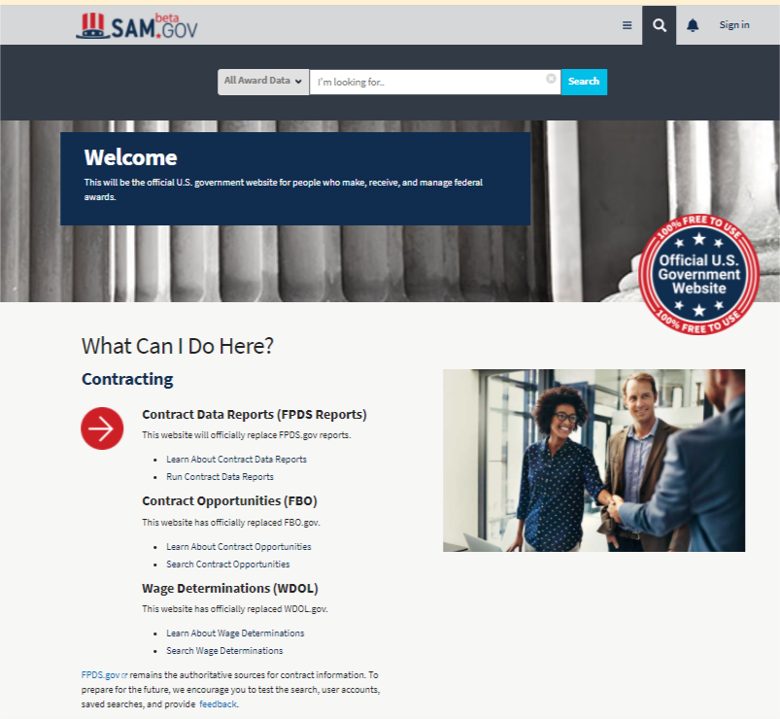
Beta sam
Beta SAM Web Site: https://beta.sam.gov/
The official U.S. government website for people who make, receive, and manage federal award.
Find out what procurements are currently advertised, to find what procurements have been awarded, to find Sources Sought notices to respond to which enable the Government to refine their acquisition method.
Learn to use Beta SAM by downloading the Quick Start Guide and reviewing videos in the User Resources section.
Register to be a Vendor at Beta SAM.
You need to be SAM registered and create account in Login.Gov
To search for NY District opportunities, use “W912DS: in the search bar as this is our specific office code.
24

Slide 25
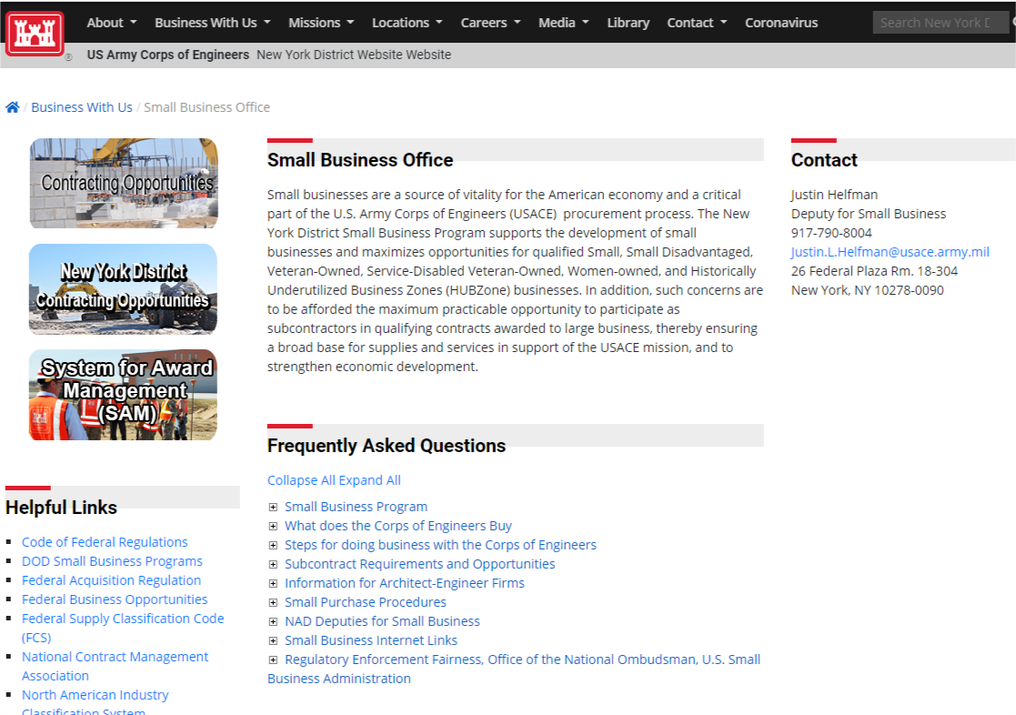
Small Business and contracting contact Information
Justin Helfman
Small Business Deputy
USACE, New York District
Phone 917-790-8004
Email: Justin.L.Helfman@usace.army.mil
Frank Cashman
Chief of Contracting
USACE, New York District
Phone 917-790-8173
Email: Francis.Cashman@usace.army.mil
“Doing Business With US” Small Business Page
https://www.nan.usace.army.mil/Business-With-Us/Small-Business-Office/

Slide 26
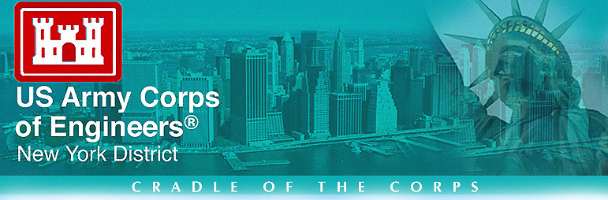

Questions?
www.nan.usace.army.mil
BUILDING STRONG®

Slide 27
NEW YORK DISTRICT
Back-up Slides

Slide 28
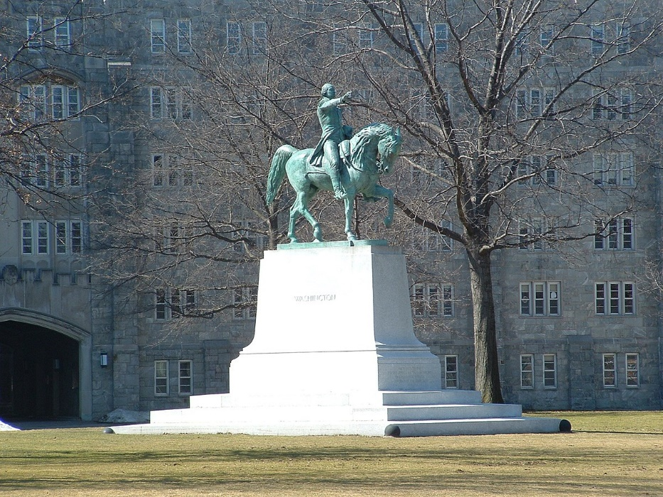
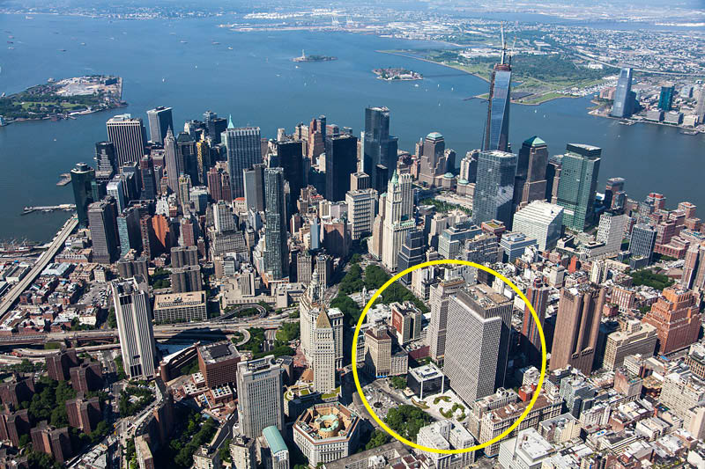
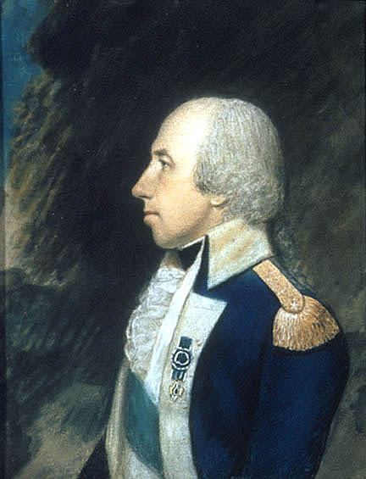
New York District: Cradle of the Corps
USMA West Point
New York District HQ
In 1776, at George Washington's directive, Rufus Putnam was appointed Chief Engineer in charge of the defenses of New York. Putnam's first task was to salvage something from the incomplete and poorly situated fortifications built around the highlands of West Point in 1775 by Bernard Romans, a Dutch engineer. We recognize Putnam as our first District Engineer.
The presence of the Corps of Engineers at West Point would continue through the next century.
In 1802, Thomas Jefferson formally established a Corps of Engineers by declaring, "that the said corps, when so organized, shall be stationed at West Point, and shall constitute a military academy."

Slide 29
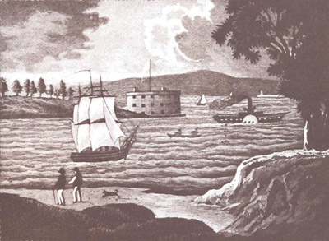
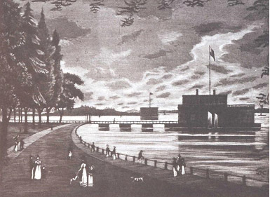
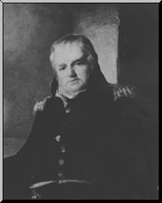
New York District: Cradle of the Corps
USACE and New York City have been connected since the beginning of our nation
In 1801 President Thomas Jefferson assigned Colonel Jonathan Williams to serve as the first superintendent of West Point
Colonel Williams was also responsible for coastal fortifications around New York Harbor
Colonel Williams planned the largest fort building scheme ever attempted in the area
No less than eight different forts or batteries were designed
& built prior to the outbreak of war of the War of 1812

Slide 30
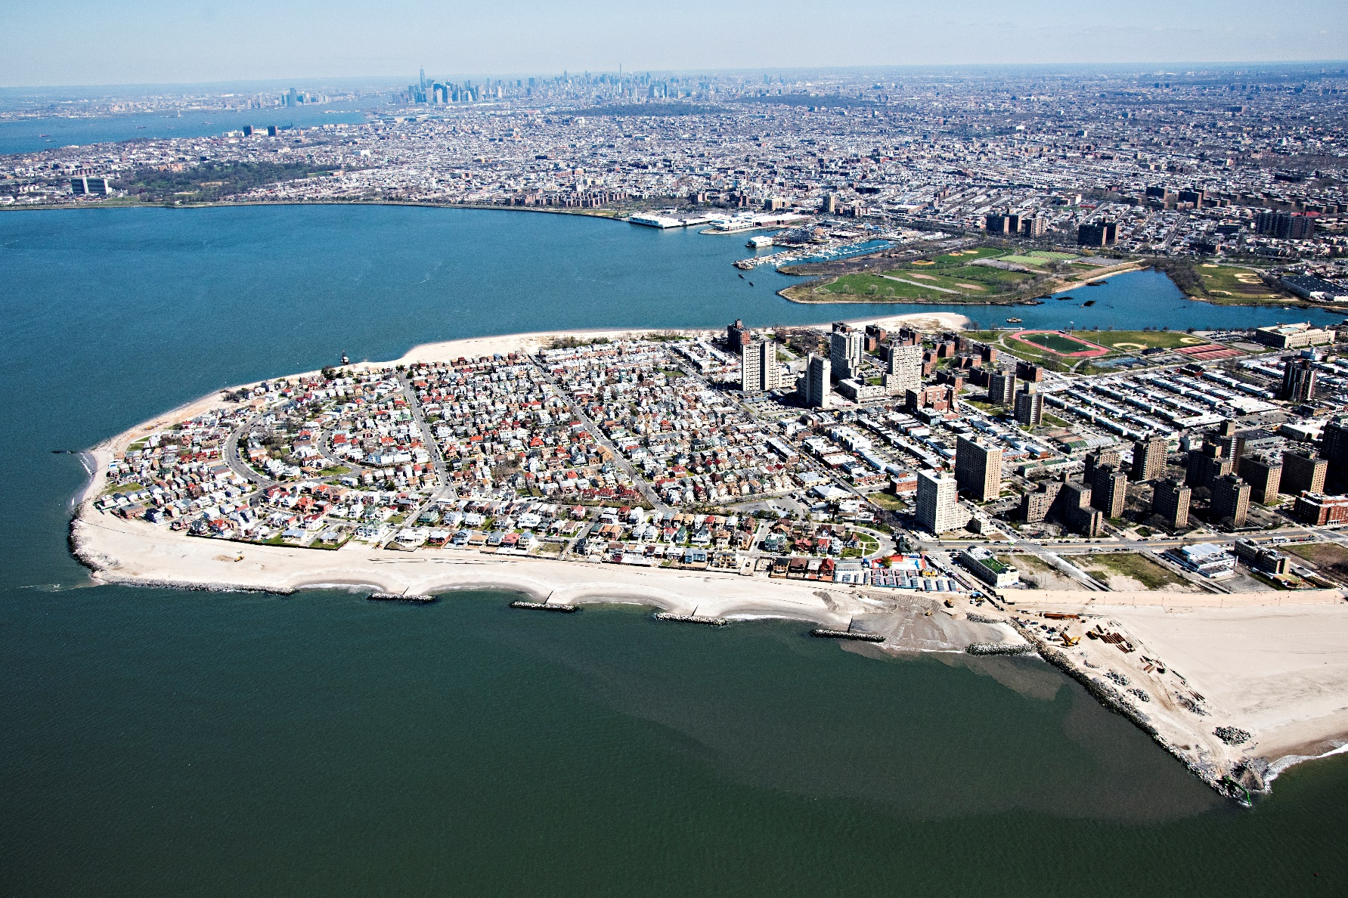
Coastal Storm Damage Reduction
Coney Island, Brooklyn, NY
Notes:
NAN CW program is made up into 3 primary lines:
Flood Risk Management (including coastal and riverine flood risk reduction): NAN is a coastal district with over 400 miles of coastline with nearby densely populated and heavily developed communities at risk to coastal flooding caused by storm surge and wave impacts. NAN has several river basins (i.e. Passaic) with densely populated and heavily developed floodplains that are at high risk to flood damages.
Environmental Restoration: The New York metropolitan region is one of the most densely populated areas in the nation and has been subject to nearly 400 years of development and urbanization, the industrial revolution, and associated environmental degradation that presents a series of significant water resources challenges due to water quality impacts, loss of wetlands, and decline of aquatic habitat.
Navigation: The Federal navigation channels are an important component of the region’s economy and transportation system in terms of commerce, jobs, and recreation. NAN has 550 miles of navigation channels, 240 of which are within the deep draft Port of NY and NJ, which is the largest container port on the East Coast and third largest in the U.S.

Slide 31
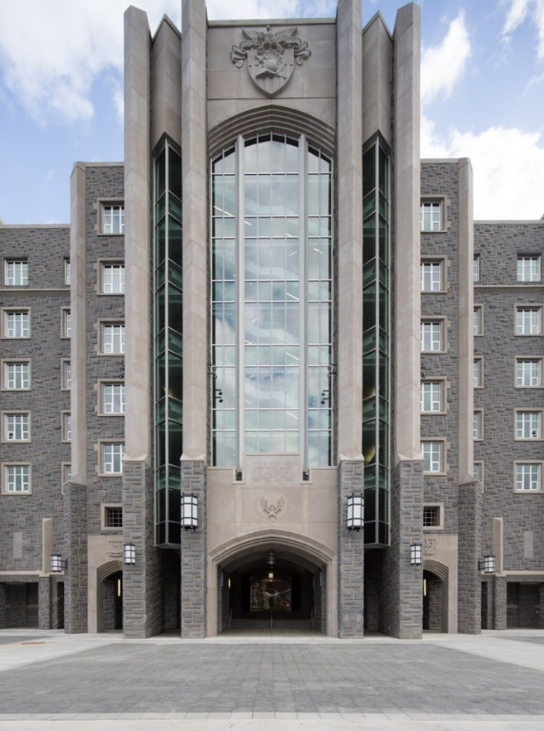
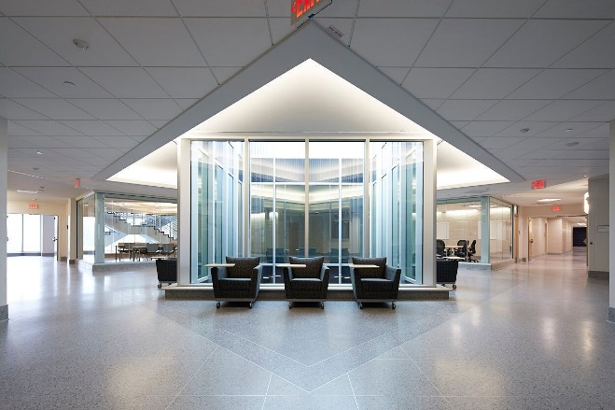
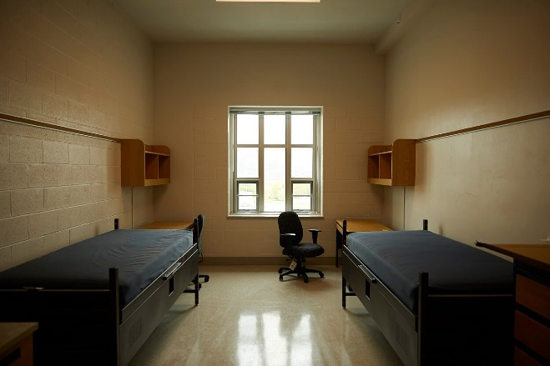
Military programs
Davis barracks
Davis Barracks houses 650 cadets in a 287,000 square-foot facility consisting of six stories in the National Landmark Historic District of USMA, West Point. It was reinforced with concrete with primarily granite cladding. The architectural detailing adheres to the historic architectural theme at West Point and in accordance with the State’s Historic Preservation.
It includes radiant heating and cooling, dedicated outdoor air systems, heat recovery systems, solar thermal and aggressive building infiltration measures. Additional sustainable features developed include rain and grey water harvesting to lessen the impact on the waste water treatment plant and additional solar thermal provisions.

Slide 32
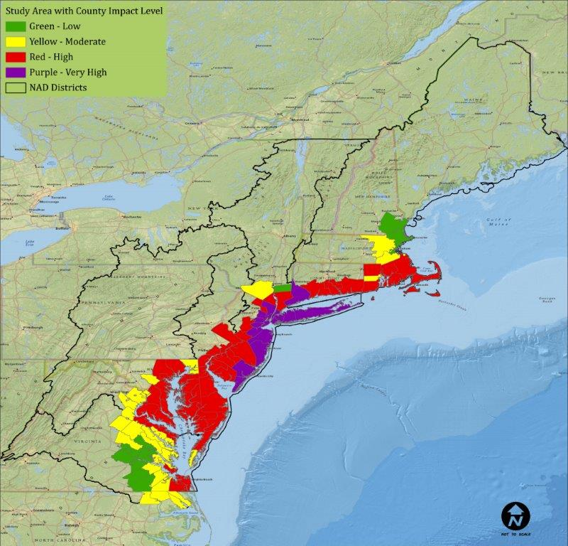
NY NJ Harbor and Tributaries
Coastal Storm Risk Management Feasibility Study
Consistent with the North Atlantic Coast Comprehensive Study report, the study will perform three overarching efforts:
Assess the problems, opportunities and future-without project conditions;
Assess the feasibility of implementing system-wide CSRM solutions; and
If system-wide solutions are not feasible, assess the feasibility of implementing site-specific solutions, such as a combination of structural, nonstructural, and natural and nature-based features (NNBF), if/as appropriate.

Slide 33
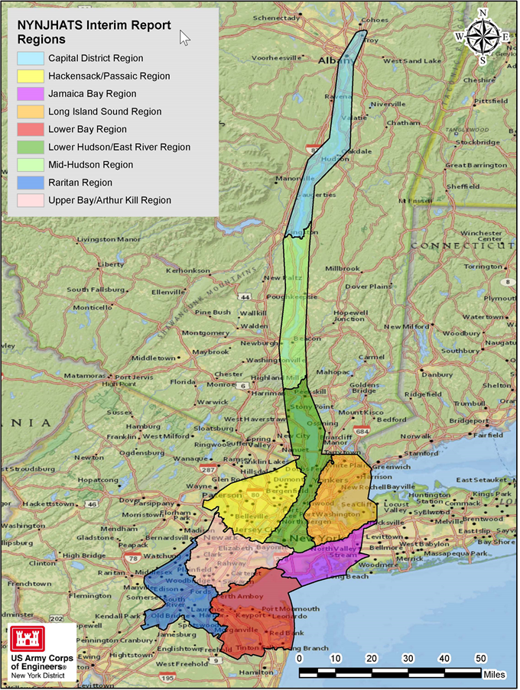
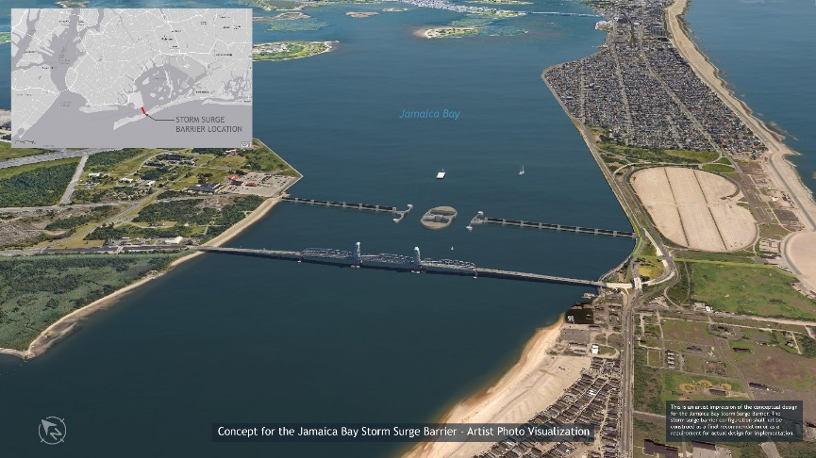
NY NJ Harbor and Tributaries
Coastal Storm Risk Management Feasibility Study
STUDY AREA & SCOPE
The largest and most densely populated of the 9 high-risk focus areas identified in the North Atlantic Coast Comprehensive Study (NACCS)
Area covers 2,150+ square miles and 900+ miles of affected shoreline
25 counties in New York & New Jersey
Affected population of roughly 16 million people, including New York City and the six most populated cities in New Jersey
Study Cost $19.4M
Study Schedule: Requesting Extension to 2024 Completion, pending further funding
COASTAL STORM RISKS & DAMAGES
Over 275,000 Structures at Risk in Study Area
Significant Potential for Future Life/Safety Risks
Incorporates Dozens of Other Ongoing and Planned CSRM Projects in Study Area
Present Value Damages for 100-Year Storm Range from $100+B for Intermediate Sea Level Rise to over
$350B for High Sea Level
Rise Projection
ALTERNATIVES
Span spectrum from Large In-Water Storm Surge Gates to Shoreline-Based Structures
Alternative Present Worth Cost Ranges from $62B to $10B
Best Solution Appears to Involve Multiple, Layered Features
Possible Phased Implementation: Actionable Features Constructed in Short-Term, Features Requiring More Evaluation & Design and Adaptation (due to further possible sea level rise) in Longer-Term
Conceptual Jamaica Bay Storm Surge Gate

Slide 34
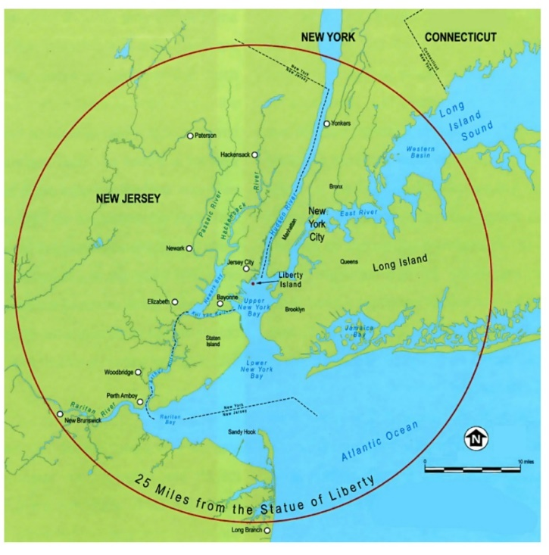
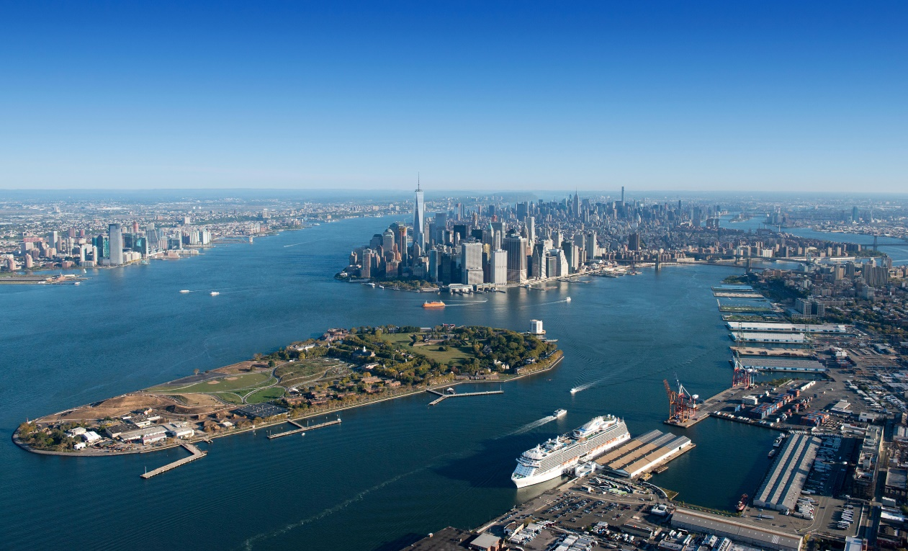
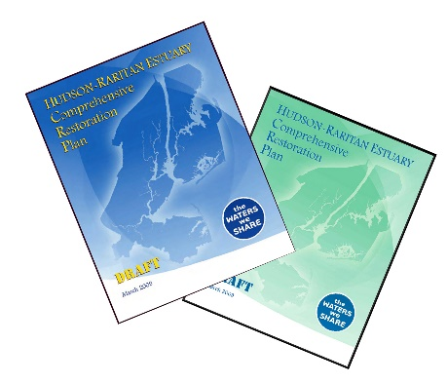
Hudson Raritan Estuary, NY & NJ
Ecosystem Restoration
Ecosystem Restoration- Identify water resource problems and restoration opportunities within 8 Planning Regions in the Port District 25 mile radius around Statue of Liberty. The Recommended Plan included restoration of wetlands, shorelines, fish passage, oyster reefs and Jamaica Bay Marsh Islands
Lower Passaic River: 2 Sites
Hackensack River: 2 Sites
Bronx River: 5 Sites
Flushing Creek: 1 Site
Jamaica Bay: 2 Perimeter Sites + 5 Marsh Islands
3 Oyster restoration sites
“Recommended Plan” (20 Sites) and
Future “Spin-off Feasibility Studies”

Slide 35
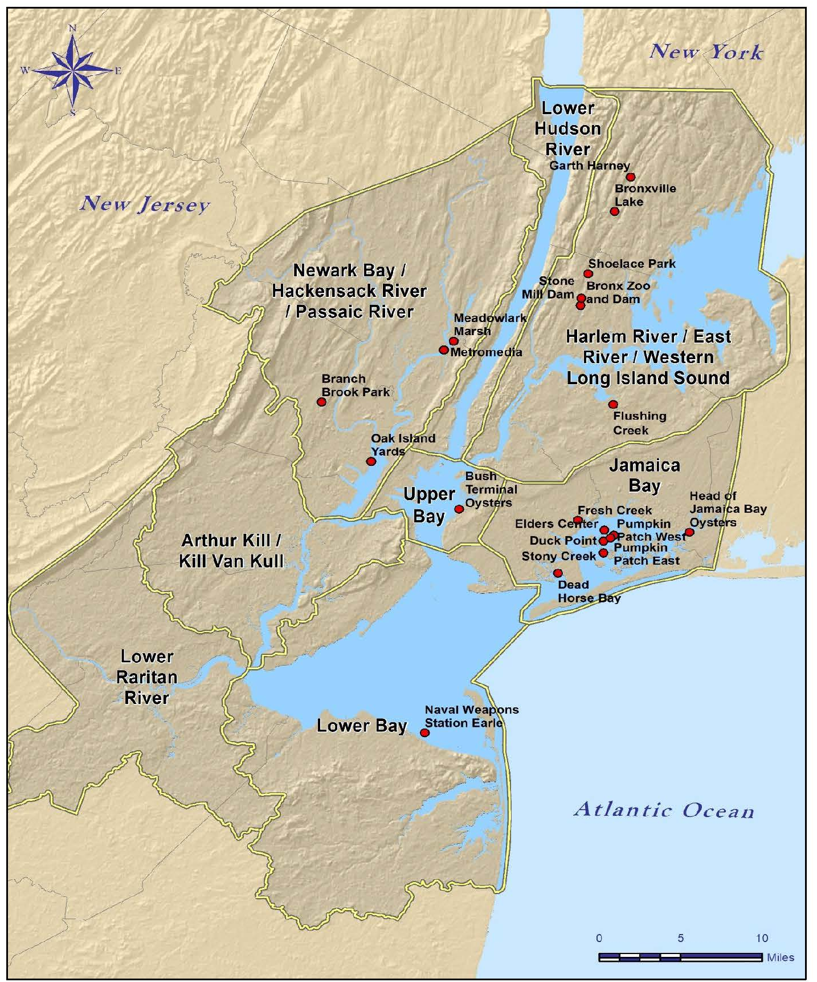
Hudson Raritan Estuary, NY & NJ
Ecosystem Restoration
Recommended construction of 20 restoration sites throughout the HRE and future feasibility studies.
Restoration of: saltwater/freshwater wetlands, oyster reefs, maritime forest, shallow water, streambanks, riverbeds and fish passage (fish ladders)
Total First Cost: $408,184,000 ($45,932,000 for PED)
Sequencing: 2023 through 2038

Slide 36
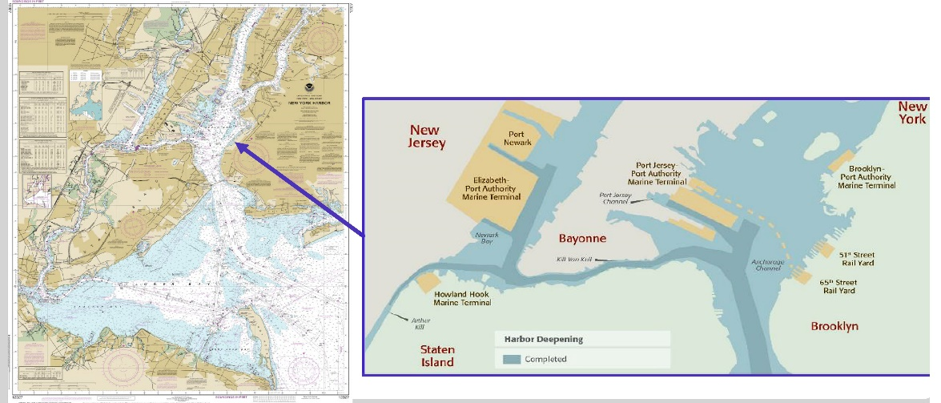
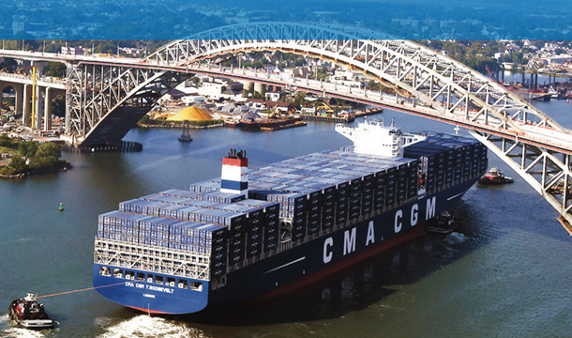
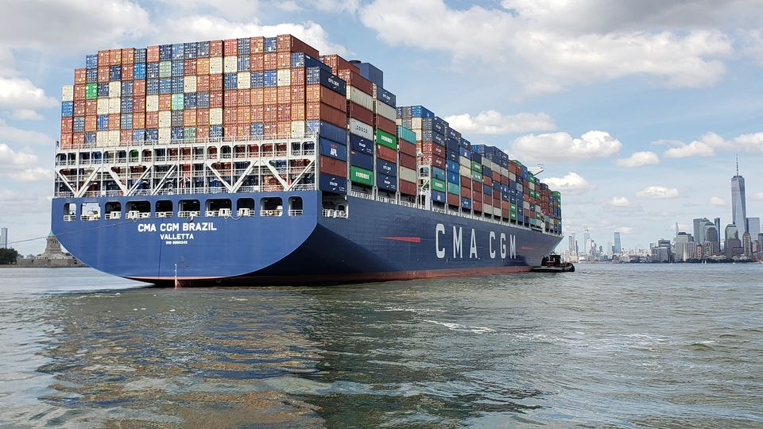
New York and New Jersey Harbor
Deepening Channel Improvement Study
Navigation improvements due to much larger capacity container vessels calling and planned to call upon the Port. Channel improvements may include selected widening and possible channel deepening
The study area is the existing federal navigation channel, including Ambrose and Anchorage Channels, and surrounding areas.
The CMA/CGM T. ROOSEVELT entered the New York Harbor in September 2017. One of the largest cargo container ship to call on the Port with a capacity of 14,414 TEUs, 20-foot equivalent units — a standard measure for container cargo. Its arrival also highlighted the completion of the Bayonne Bridge Navigational Clearance Project.
The CMA/CGM BRAZIL entered the New York Harbor September 12th, 2020.The 1,200-foot-long CMA/CGM Brazil is one of the largest in the world and holds the title as the largest-capacity container ship to enter the Port with a capacity of 15,072 TEUs.

Slide 37
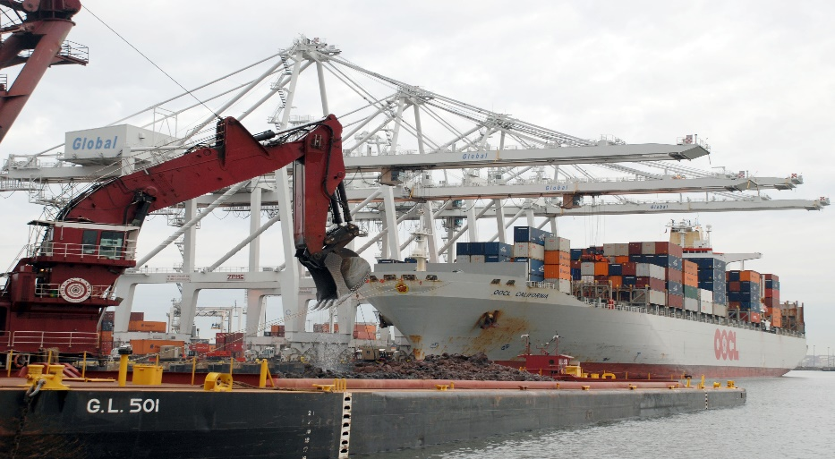
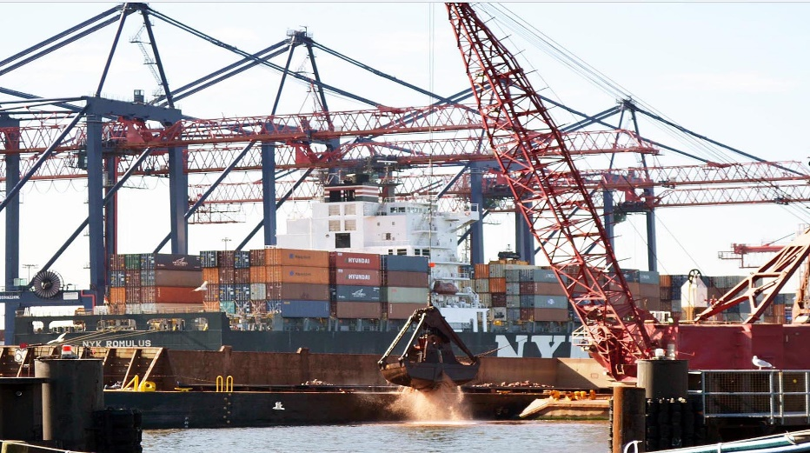

New York and New Jersey Harbor
Deepening Channel Improvement Study
Harbor Deepening & Channel Improvements Feasibility Study
Draft Study due Oct. 30, 2020
Chief’s Report due May 2020

Slide 38


A Vision of a World Class Harbor Estuary
Navigation/Port
Environment
Restoration Program:
Hudson Raritan Estuary
Hudson River
Liberty State Park (NJDEP)
Harbor Deepening (50-ft) and O&M Dredging
Drift/Floatables Removal
Beneficial use of Dredged Material
Harbor Operations
Spring Creek
Old Place Creek
Jamaica Bay Islands
Environmental Remediation (EPA)
NY/NJ Harbor Deepening Channel Improvement Study
Anchorage Study
Resiliency Projects
NY/NJ Harbor and Tributaries Study
Rockaways
Port Monmouth/Union Beach
Emergency Operations
Passaic River Tidal
South Shore of Staten Island
Minish Park
Rahway Tidal
Safety/Security

Slide 39



NEW YORK DISTRICT
Operations During COVID-19 Pandemic
Alternate Care Facilities USACE worked in support of FEMA - and in coordination with other federal, state, local partners – to synchronize the interagency response to the COVID-19 Pandemic. USACE assessed a variety of facilities, for Alternate Care Facilities including: hotels, arenas, hospitals/medical facilities, office buildings, fairgrounds, prisons, barracks, and ultimately 4 facilities were constructed.
USNS Comfort New York District expedited the necessary permits for dredgers to make way for the ship USNS COMFORT.

